Slide 1
Emotional Health
Section 1 Self-Knowledge

Slide 2
Section 1 Self-Knowledge
What do you think?
Emotional health is not related to physical health.
Once a person adopts values, they remain firmly fixed for a lifetime.
It is best to reject illogical or unpleasant feelings.

Slide 3
Section 1 Self-Knowledge
Self-Confidence
If you possess emotional health, you seek, value, and maintain good relationships with yourself, with others, and with society.
These relationships are a key part of total wellness.
In contrast, many people who are emotionally unhealthy are self-destructive

Slide 4
Section 1 Self-Knowledge
One of the most important relationships in your life if the relationship you have with yourself.
Your relationship with yourself must support you throughout your life.
It also helps support the relationships you have with others and society.

Slide 5
Section 1 Self-Knowledge
To develop a good relationship with yourself:
You first need to think about yourself.
Get to know yourself as you are right now.
Develop a relationship with yourself that pleases you.
“This is the way I am, and I feel OK about it”.
Self Confidence is attractive.

Slide 6
Section 1 Self-Knowledge
Being self confident is not the same as being conceited.
Conceited- A person who has falsely high opinions of him or herself.
Self-confidence starts with self-knowledge.
Self-confidence begins when you ask yourself “Who am I?”

Slide 7
Section 1 Self-Knowledge
Writing Assignment:
Take out blank piece of paper and write a 1 page essay titled Who Am I? Describe who you are as a person, not simply the things you do i.e. play football, baseball, etc. Talk about your values: where they came from, what is important to you, and how others would describe you. Please Be Honest!!!
Essay is worth 10 participation pts

Slide 8
Section 1 Self-Knowledge
Thoughts
Thoughts- those mental processes of which a person is always conscious.
Take place in the outermost layer of your brain- CORTEX.
Helps you gather information about yourself and the world around you, and to make sense of it.
Your thoughts shape your actions.

Slide 9
Section 1 Self-Knowledge
THINKING POSITIVELY
If you think constructive, positive thoughts, you will act in constructive, positive ways.
Recognize your own negative thoughts.
Stop the negative thoughts.
Replace negative thoughts with positive thoughts.

Slide 10
Section 1 Self-Knowledge
Values
What are values?
They are a person’s set of rules for behavior; what a person thinks of as right or wrong, or sees as important.
They have been called “life’s steering wheel, because they guide the direction your life takes.

Slide 11
Section 1 Self-Knowledge
Values
Values change from time to time. Working them out remains a life long task.
Your values guide you in assigning + and – behaviors.
Values are both conscious and unconscious.

Slide 12
Section 1 Self-Knowledge
Values
When two values a person holds conflict with each other, decisions and actions become difficult.
Should I have fun (value: enjoy life) or should I study (value: good grades).
Should I tell my friend a true but unpleasant fact (value: honesty) or should I protect my friends feelings (value: friendship).

Slide 13
Section 1 Self-Knowledge
Who Am I?
Take out a sheet of paper.
Tell me who you are, what do you value, what are the important things in your life, what makes you special, what motivates you, what do you struggle with, are you happy with your values.

Slide 14
Section 1 Self-Knowledge
Emotions
What is an emotion?
An emotion is a feeling that occurs in response to an event as experienced by an individual.
Emotions present at birth- affection, anger, fear.
Emotions learned- envy, prejudice.
Emotions & feelings have been used to mean the same thing.

Slide 15
Section 1 Self-Knowledge
Emotions
The emotions you feel in response to an event often depend on earlier experience of the same kind. -Car Crash/ gets nervous in a car.
Emotions/ feelings are acceptable- all of them!
It is acceptable to feel anything- but it may not be acceptable to act on that feeling.
-Anger/ hit someone.

Slide 16
Section 1
Emotions
You should face your emotions/ feelings as soon as possible.
Emotions can build up, making it difficult for a person to function.
People who are aware of their feelings and who express them appropriately are more emotionally healthy.

Slide 17
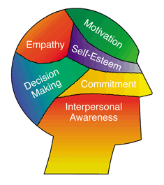
Section 1 Self-Knowledge
Emotions
Emotional Intelligence- The ability to recognize and appropriately express one’s emotions in a way that
enhances life.

Slide 18
Section 1 Self-Knowledge
Dealing with Emotions
1. Recognize it. What am I feeling?
2. Own it. Accept that you feel it.
3. Verbalize it. Express it in words to yourself or others.
I’m angry!, Sad☹, Excited☺.
4. Express it physically. Hug someone, jump in the air, laugh, cry, write about it.
5. Think about the situation. A confrontation maybe necessary.

Slide 19
Section 1 Self-Knowledge
Expressing Emotions
A person who feels anger but cannot express it holds it inside and builds resentment instead.
Resentment- anger built up due to failure to express it.
Someone that is holding back from expressing a feeling is suppressing that feeling.
Suppress- to hold back or restrain.

Slide 20
Section 1 Self-Knowledge
Confrontation
A showdown, an interaction in which one person expresses feelings to another.
Managed aggressively- a confrontation maybe a destructive fight.
Managed assertively- a confrontation maybe a constructive conversation in which one person makes his/her wishes known to another.

Slide 21
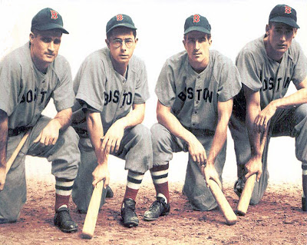
Section 2
Section 2
Relating to Others

Slide 22
Section 2 Relating to Others
People who value themselves, because they are confident and happy, attract other people into friendships.
SUPPORT SYSTEM- a network of individuals or groups with which one identifies and exchanges emotional support.

Slide 23
Section 2 Relating to Others
Who can form a support system?
- Family members, neighbors, school friends, members of a sports team…
An advisor or a mentor are also examples of people you can form a support system.
What is a mentor?
- A wise person who gives advice and assistance.

Slide 24
Section 2 Relating to Others
Dealing with Conflicts
People deal with conflict everyday.
- At home, school, work, or out with friends.
So the question is not whether you will experience conflicts, but how will you handle them.
It’s important to learn how to keep your cool but still stand your ground.

Slide 25
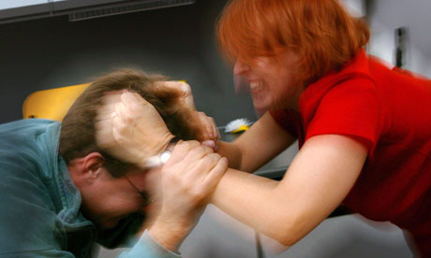
Section 2 Relating to Others
Dealing with Conflicts
If you don’t stay calm, the conflict could lead to violence.
Violence- brutal physical force intended to damage or injure
another.

Slide 26
Section 2 Relating to Others
Dealing with Conflicts
Feud- a bitter, continuing hostility, often involving groups of people.
Tolerance- accommodation and acceptance of differences between oneself and others; being tolerant of people’s age, body shape, gender, disabilities, race, religion, views, and other differences.

Slide 27
Section 2 Relating to Others
How to Resolve Conflicts
Be honest and assertive. Say what you mean and what you feel.
Use only “I” statements rather than “you” statements.
Reflect. Repeat the other person’s complaints in your own words- and wait for agreement.
Ask- don’t guess. You don’t really know what’s on the other person’s mind until you ask.

Slide 28
Section 2 Relating to Others
How to Resolve Conflicts (Cont)
Take a side-by-side attitude. Put yourself in the other’s shoes.
Use humor. Laughter relieves stress.
Choose a good time and place for working out issues.
Solve only one issue at a time.

Slide 29
Section 2 Relating to Others
How to Resolve Conflicts (Cont)
Be sure that the issue at hand is the real issue.
Stand up for yourself! Ask for specific changes that will lead to an end to the conflict.
Be open to change yourself.
Don’t try to win. If there’s a winner there’s a loser. Both people should win.

Slide 30
Section 2 Relating to Others
How to Resolve Conflicts (Cont)
If you fail, try again with a MEDIATOR present.
What is a mediator? A mediator is a neutral third person who helps two people in conflict to communicate.

Slide 31
Section 2 Relating to Others
The 1st task in resolving a conflict is to establish that true conflict exists. People naturally express different viewpoints, or react differently to the same event, and these differences are best tolerated. Also some people waste energy dwelling on a past wrongdoing.

Slide 32
Section 2 Relating to Others
True conflict, though, is another matter. Left unsettled, conflict can ruin relationships, interfere with work or school performance, and even lead to violent acts of revenge, especially when people believe their honor is at stake.

Slide 33
Section 2 Relating to Others
STRATEGIES FOR RESOLVING CONFLICTS
Conflicts that are well handled can end constructively.
People who face up to their disagreements with others are motivated to make things better.
With the right attitude, people can break down barriers and create more trust- essential for resolving conflict.

Slide 34
Section 2 Relating to Others
BOTH PARTIES SHOULD ADJUST THEIR ATTITUDES TO THE FOLLOWING:
Desire Resolution: have a genuine desire to solve the problem.
Join In Teamwork: be willing to work together to find solution.
Strive for win-win: Know that if each person helps meet the other’s needs, everyone’s needs can be satisfied.

