Slide 1
Nutrition
Chapter 7

Slide 2
Fact or Fiction?
To be well nourished is simply a matter of eating foods with enough of the right nutrients.
FALSE- Eating foods with enough nutrients is important, but equally important is to keep from eating too much or too little food.
Honey & Sugar are the same, as far as the body is concerned
TRUE

Slide 3
Fact or Fiction?
Of all the things in foods that cause diseases, sugar is probably the biggest trouble maker.
FALSE- Fat is by far the biggest culprit
A teaspoon of fat has more than twice the calories of a teaspoon of sugar.
TRUE
Electrolytes are dissolved minerals that carry electrical charges.
TRUE

Slide 4
Fact or Fiction?
To be sure to get enough protein, you must eat meat.
FALSE- You can easily get enough protein from grains, beans, vegetables, milk, and eggs without eating any meat.
Vitamin supplements can be useful in treating many diseases.
FALSE- The only disease that a vitamin supplement will cure is the one caused by a deficiency of that vitamin.

Slide 5
Fact or Fiction?
The best dietary measure against cancer is to take antioxidant vitamin pills each day.
FALSE- The best dietary measure against cancer is to consume at least 5 servings of vitamin-rich fruits and vegetables each day.
Most people easily get enough calcium, because it is found in so many foods.
FALSE- Low intakes of calcium are common, because few foods contain large amounts.

Slide 6
INTRODUCTION TO NUTRITION
You choose to eat a meal about a 1,000 times a year.
You will choose when to eat, what to eat, and how much to eat about 65,000 times in your lifetime (if you live to be 65).
You will consume about 50 tons of food.

Slide 7
INTRODUCTION cont.
The average American consumes 130 pounds of fat per year.
This amount of fat would be equal to eating more than one full stick of butter each day.
Each day’s intake of nutrients may affect your body only slightly, but over a period of years, the effects of those intakes builds up.
This is why it’s important for you to learn now to make wise food choices.

Slide 8
BENEFITS OF NUTRITION
Good nutrition helps make people’s bodies strong, fit, and healthy
Bodies are beautiful in many different ways, but to be it’s most beautiful, it must be well nourished.
Adequate intakes of all the nutrients underlie the health of your complexion, the straightness of your bones, the shape and strength of your muscle, and the gleam in your eye.

Slide 9
The Best Food for You
Your body is growing and renewing its parts all the time.
Each day it adds a little to its tissues as you gain height and strength.
It also replaces some old muscle, bone, skin, and blood with new tissues.
In this way some of the food you eat today becomes part of “you” tomorrow.

Slide 10
Best Food for You…
The best food for you, then, is the kind that supports normal growth and maintains strong muscle, sound bones, healthy skin, and enough blood to cleanse and nourish all the parts of your body.
It should also reduce your risks of developing illness later in life.
Your food choices along with your lifestyle choices either raise or lower your chances of becoming ill.

Slide 11
Dietary Guidelines for Americans
Eat a variety of foods.
Balance the food you eat with physical activity- maintain or improve your weight.
Choose a diet with plenty of grain products, vegetables, and fruits.
Choose a diet low in fat, saturated fat, and cholesterol.
Choose a diet moderate in sugars.
Choose a diet moderate in salt and sodium.

Slide 12
DEFICIENCIES AND MALNUTRITION
Some people do not obtain enough nutrients from their food. They may develop nutrient deficiencies or other forms of malnutrition.
Nutrient Deficiencies- Too little of one or more nutrients in the diet. A form of malnutrition.
Malnutrition- The result in the body of poor nutrition; under nutrition, over nutrition, or any nutrient deficiency.

Slide 13
DEFICEIENCIES AND MALNUTRITION cont.
Adolescents & teens are sensitive to deficiencies because they are growing at astonishing rates.
A person who does not receive proper nutrition during the teen years may never reach full height, because of all of the nutrients they need for growth.
After the person reaches adulthood, growth stops, even if the diet is excellent.

Slide 14
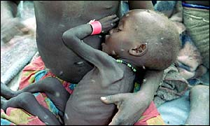
UNDERNUTRITION
A form of malnutrition caused by inadequate food intake or the body's inability to make use of needed nutrients.

Slide 15
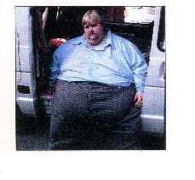
OVERNUTRITION
Too much food energy or excess nutrients to the degree of causing disease or increasing the risk of disease.
Regarded as a form of malnutrition when it leads to morbid obesity

Slide 16
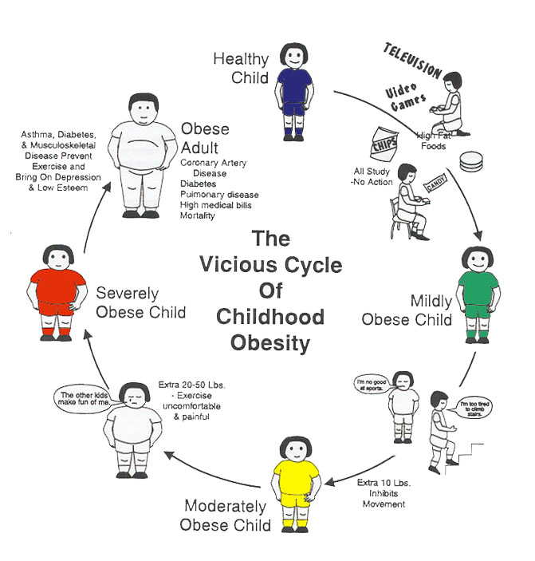

Slide 17
KEY POINTS
Good nutrition promotes growth and helps prevent diseases.
Both under nutrition & over nutrition threaten health.

Slide 18
How many servings per Day?
Calories | Active Female Teen 2,200 | Active Male Teen 3,200
Fruits | 2 cups | 2 ½ cups
Vegetables | 3 cups | 4 cups
Grains | 7 ounces | 10 ounces
Protein | 6 ounces | 7 ounces
Dairy | 3 cups | 3 cups
Oil | 6 teaspoons | 11 teaspoons
Extras-fat and sugars | 290 calories | 650 calories

Slide 19
Energy From Nutrients
Carbohydrate
Provides energy as glucose
Fat
Provides energy as fatty acids
Protein
Builds working body parts and can provide energy as amino acids

Slide 20
Energy Contributions from Nutrients
Carbohydrate
4 calories per gram
Fat
9 calories per gram
Protein
4 calories per gram

Slide 21
Carbohydrates Important in our Diet
Starch:
The main carb in grains and vegetables, is the main energy source for people around the world
Fiber:
Helps maintain the health of the digestive tract. The body needs about 25 grams of fiber each day
Sugars:
Carbs found both in foods and the body.
Glucose: blood sugar of body’s fuel
Fructose: natural sugar in fruits and honey
Sucrose: also known as table sugar
Lactose: natural sugar in milk

Slide 22
Fats
Fat supplies most of the body’s fuel
Some types of fat are essential and important for a healthy nervous system
Fat is stored in a layer of cells beneath the skin, mainly in the abdomen
Body fat helps insulate the body and protects the organs from shocks and bruises
Too much body fat, however, is not healthful!

Slide 23
Fats
The fats you consume come in two forms.
Saturated Fats
Mainly animal sources, including meat, whole milk, butter, and cream. These fats strongly associated with heart disease
Unsaturated Fats
Mainly come from vegetable oils. These fats less associated with heart disease
Polyunsaturated Fats
A type of unsaturated fat which is useful as a replacement for saturated fat in a heart-healthy diet.

Slide 24
Proteins
Proteins are the body’s machinery. Protein is found in meats, fish, poultry, eggs, cheese, milk, grains, and beans.
A set of 20 different amino acids form proteins
Your body can make some of the amino acids for itself, but essential amino acids cannot be made by the body and must be eaten in foods.
A person who does not consume enough protein can become protein deficient.

Slide 25
Vitamins
There are two types of vitamins:
Fat-soluble
Vitamins able to dissolve in fat and remain in the body
Can be dangerous if a person takes too much
Water-soluble
Vitamins able to travel in the body’s watery fluids and leave the body readily in urine
You should eat foods that provide these types of vitamins regularly to replace those that you have lost

Slide 26
Minerals
All minerals, even those present in tiny amounts, are essential for proper body functioning
Calcium is the most abundant mineral in the human body
Iron is present in every living cell and is the body’s oxygen carrier
Not having enough iron can cause anemia
Electrolytes are minerals that dissolve in the body’s fluids and carry electrical charges. They help maintain proper balance of fluids in the body
Sodium, chloride, and potassium

Slide 27
Reading Food Labels

