Slide 1
Industrial Revolution
Does Technology benefit society?
Chapter 22 and 23

Slide 2
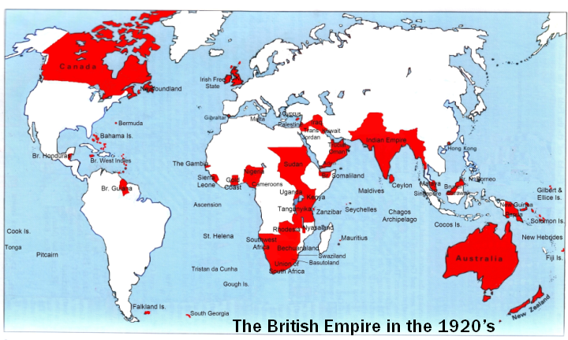
Great Britain controlled 25% of the world! WOW!

Slide 3
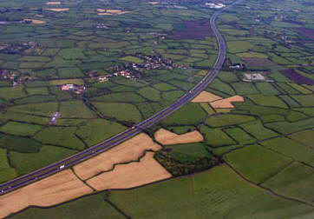
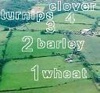
Agricultural Revolution
Change in farming
Changes:
  Enclosure Movement
    Lands “fenced off”
  Crop Rotation
    Plant diff. crops in fields ea. Year
    Invented by Charles “Turnip” Townshend
  New Machines

Slide 4
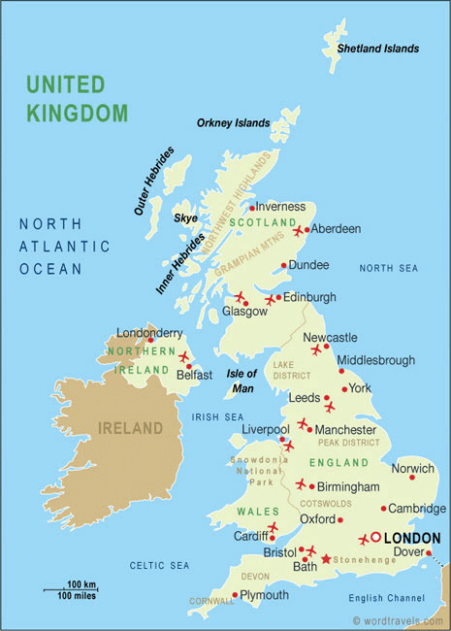
Industrial Revolution
Era of rapid industrial development
Began in England
  B/C had ALL factors of production (land, labor, capital)
    Land- natural resources, rivers, harbors
    Labor- Population & migration to cities
    Capital- $, tools, machines

Slide 5
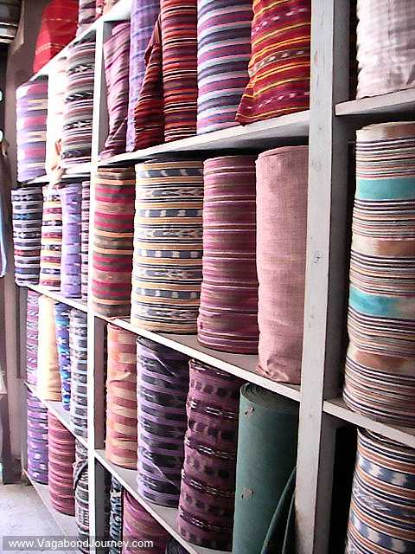
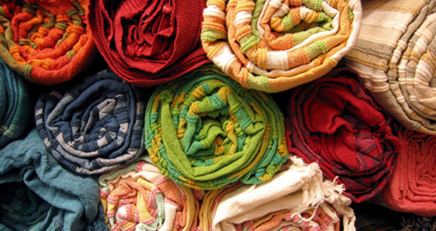
Textile Industry
AKA - cloth industry
1st industry to be mechanized (replaced by machines)
Old way = Cottage/Domestic system
  Making goods at home
New way = Factory System

Slide 6
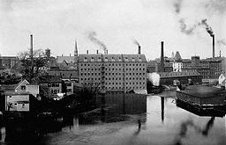
Factory System
Production in 1 place
Factory near power source
Workers paid fixed hourly wage
Goal = Mass Production (make large #’s of identical items)

Slide 7
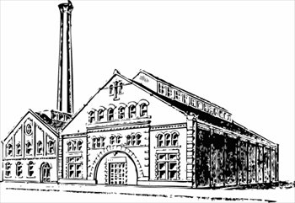
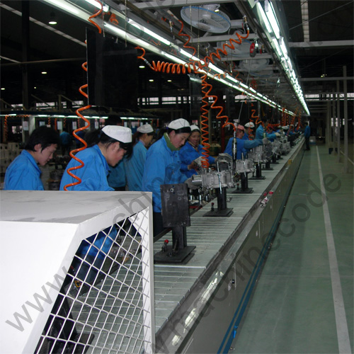
Factory System: How it Works
Process:
  Division of Labor
    Hire unskilled worker
    Worker makes 1 interchangeable (identical) part of whole product
  Assembly Line
    Products move from worker to worker until end product created

Slide 8
How did the Industrial Revolution Change Society?

Slide 9
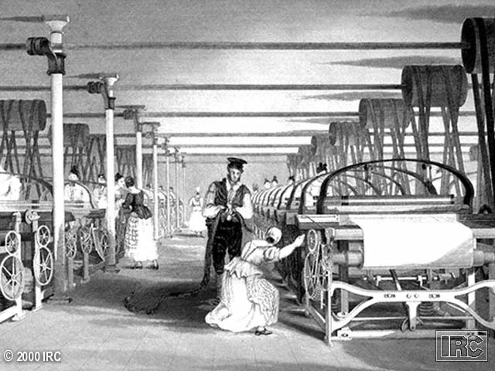
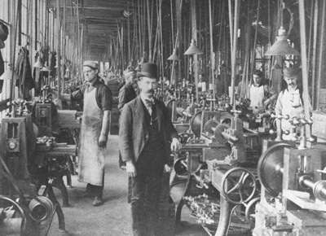
Lives of Factory Workers/Proletariat

Slide 10
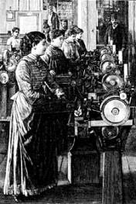
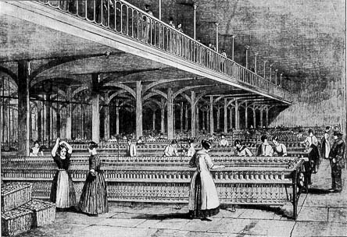
Women

Slide 11
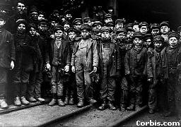
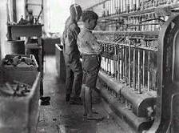
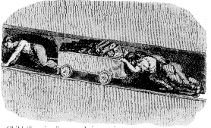
Child Labor

Slide 12
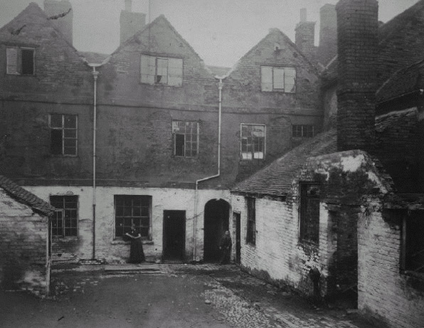
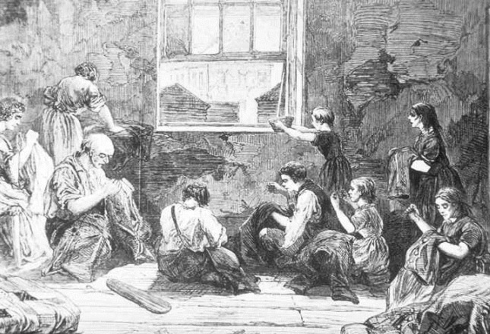
Worker Housing/Tenements

Slide 13
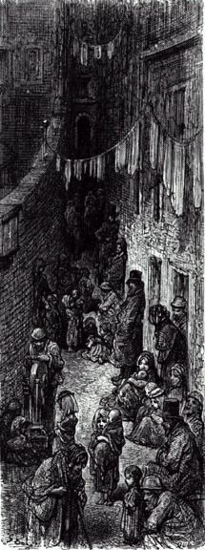
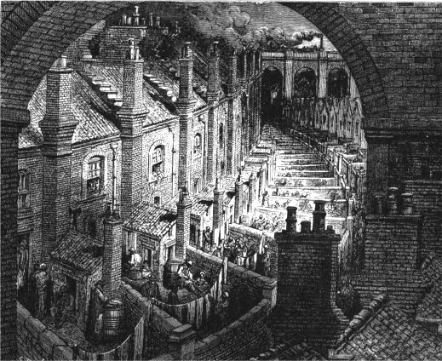
The New Industrial City

Slide 14
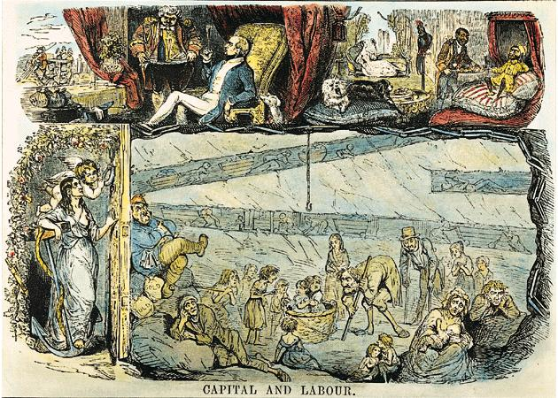
“Up Stairs” / “Down Stairs” Life

Slide 15
Factory Owners/Capitalists
Capitalism
  Econ. system where individuals or corporations, not gov., own factors of prod.
Corporation
  Businesses form groups to work together
Monopoly
  Corporation controls almost all prod. of good

Slide 16
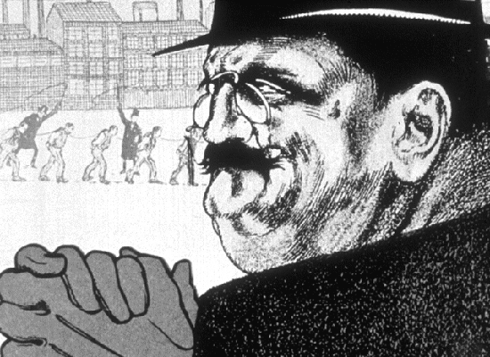
Stereotype of Factory Worker/Capitalists

Slide 17
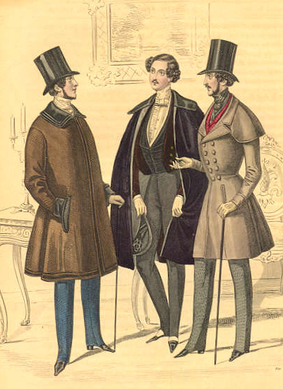
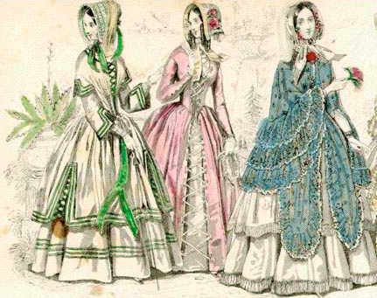
Bourgeoisie: The New Upper Class
Owners of
capital/means of
production

Slide 18
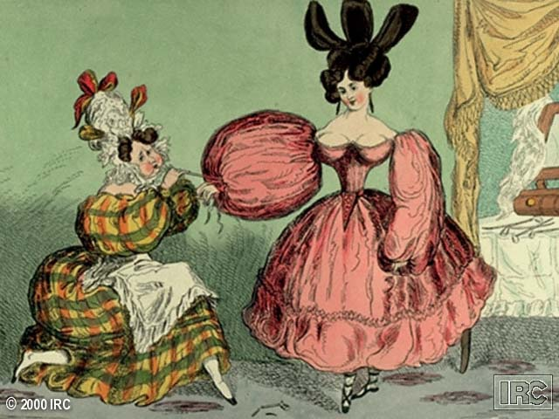
Criticism of the New Bourgeoisie

Slide 19
New Economic Theories
Mercantilism OUT!
Free Enterprise (no laws or regulations) IN!
  Adam Smith
    2 Natural Laws of Business
      Law Supply and Demand
      Law of Competition
    Consequence
      Business Cycle – alternating periods of and
New laissez-faire (“leave things alone”) theory appealed to Factory Owners/Capitalists
WHY?

Slide 20
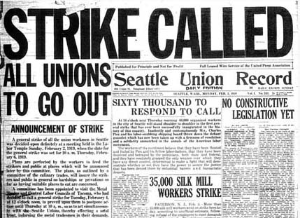
Attempts to Reform Inequalities
Humanitarians
  People who worked to improve conditions
Collective Action – aka “Unions”
  Strikes
  Collective bargaining

Slide 21
Attempts to Reforms
Factory Acts (1802 & 1833)
  Shorter workdays
  Age requirements
  Improve fact. conditions
Factory Acts Unsuccessful
  Not enforced
  Ex: Triangle Shirtwaist Fire (1911)

Slide 22
A New System All Together
Socialism
  Econ. & political system
  Gov. own means of production (MoP)
  Gov. operates (MoP) for benefit of all people
Many variations of Socialism
  Utopian Socialism-All people would own all means of production in common and share the products.
  Marxism-believed that each stage of history involved inequality. The rich and the poor. He dreamed of Revolution in which the workers of the world would unite to gain political power.

Slide 23
Government Types Cont.
  Communism-Government owns all means of production and controlled all economic planning. No civil rights!
  Democratic Socialism- Northern and Western Europe. People retain partial control over economic planning through the election of government officials.

Slide 24
Do the advancements of the Industrial Revolution out way the hardships and inequalities that developed because of the Industrial Revolution?

