Slide 1
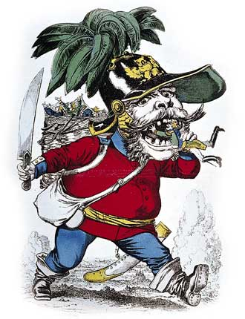
Opposition to Bismarck 25.3

Slide 2
Unrest in Austria: Coping with Nationalistic Movements
Chapter 25.5

Slide 3
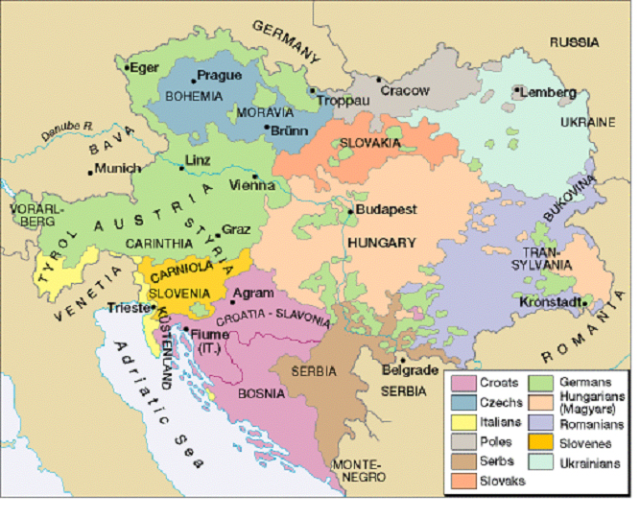
The Decline of the Austrian Empire
Status of Austria very poor:
Lost HRE
Italy
Revolts broke out
Hungary
“The Last Straw”
Lost 7 Weeks’ War

Slide 4
The Dual Monarchy
To save the empire, Austria gave in to Hungarian demands and created a Dual Monarchy (aka Austria-Hungary)
Led by Francis Joseph I
Strengths | Weaknesses
-Provided markets for ea. other (A- Ind. & H- Ag.) -Ended revolts | -Tariffs (A. wanted high taxes) -Ethnic divisions -Austria weak

Slide 5
Austria-Hungary’s New Focus
Wanted to control the Balkans
Not an easy task:
Needed to take away from Ottomans
Balkan people wanted independence
European countries also wanted to control Balkans (GB and Russia)

Slide 6
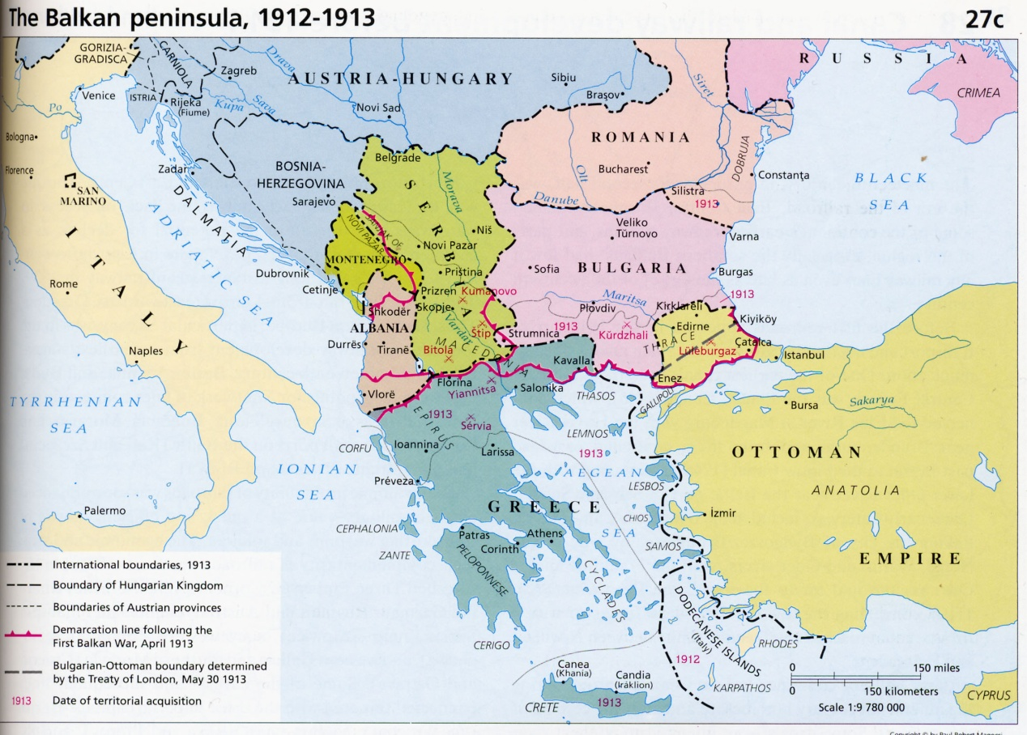
Dividing the Balkans
1875 Balkan revolts ended w/ Ottoman defeat
Treaty of San Stefano
Romania, Serbia, Montenegro, independence.
Self-Rule to Bulgaria ( which Russia then occupied for years.
At the Congress of Berlin:
GB , Russia, Ottomans given some terr.
A&H governed Bosnia and Herzegovina
Later A&H took B&H o/
Result:
Ottoman Empire weak
Balkan states resent A&H

Slide 7
Dividing the Balkans
At the Congress of Berlin:
GB , Russia, Ottomans given some terr.
A&H governed Bosnia and Herzegovina
Later A&H took B&H o/

