Slide 1
Great Depression & The New Deal 1929-1941

Slide 2
Presidents during the Great Depression
Herbert Hoover 1929-1933
Franklin D. Roosevelt 1933-1945

Slide 3
Causes of the Great Depression
1. Stock Speculation
Buying stock when the price is low and selling it when the price rises in hopes of making a quick profit
When stock market crashed many Americans were left with worthless stock

Slide 4
Causes of the Great Depression
2. Buying on the margin
People were able to purchase stocks by paying as little as 10% of the stock’s value
They then borrowed the rest of the money from the bank or the stock broker in hopes of repaying when the stocks increased

Slide 5
Causes of the Great Depression
Overproduction
-various industries kept up production even though there was not a demand from the market
-Examples: Automobiles, crops, construction
*Supply exceeded demand which made prices fall

Slide 6
Causes of Great Depression
4. Uneven distribution of wealth
“The rich got richer and the poor got poorer.”

Slide 7
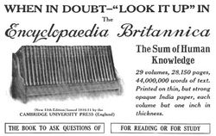
Causes of the Great Depression
5. Consumer Debt
Americans were in debt due to installment buying in the 1920’s for household and farming goods

Slide 8
Causes of the Great Depression
6. International Debt
U.S. lent millions of dollars to the Allies in WWI and those countries were not able to repay loans

Slide 9
Causes of the Great Depression
7. Lack of government regulation of businesses and the stock market

Slide 10
Causes of the Great Depression
8. Stock Market Crash-October 29, 1929-Black Tuesday
The spark that began the depression
16 million shares of stock were traded
By the end of 1929, stock price losses exceeded that of the cost of WWI
Crowd outside of Wall Street on Black Tuesday

Slide 13
Effects of the Great Depression
Effects on society
25% of the workforce were unemployed at its peak
Wages were as low as $.10 per hour
Blacks often first fired
Women who worked for less than men were often retained
Many sold produce on the street

Slide 14
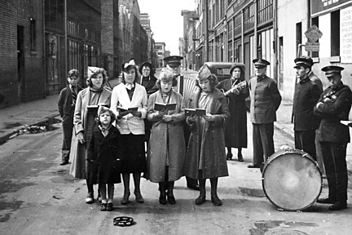
Effects of the Great Depression
Effects on Cities
Cities tried to provide relief with Red Cross and Salvation Army
Breadlines were common
Hoovervilles
Poverty and crime spread throughout US
Job Bureau
Salvation Army
Hooverville with Christmas Tree

Slide 15
Effects of the Great Depression

Slide 16
Effects of Great Depression
Effects upon farming
Farmers had more than they could sell-prices dropped
Farmers could not afford mortgages and many “lost the farm”

Slide 17
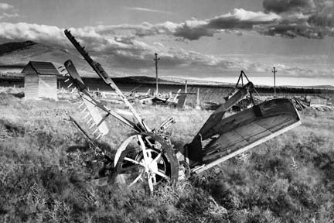
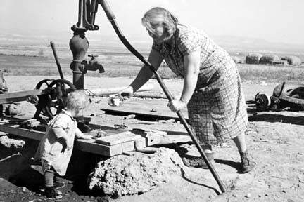
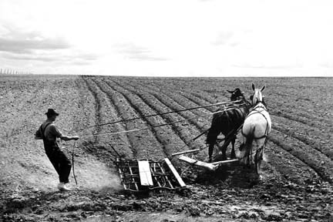
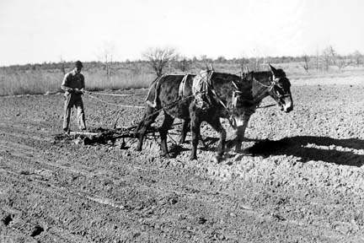

Slide 18
Effects of Great Depression
Effects of families
Families moved in together
Divorce rates rose
Women made their own bread, soap, clothes
Families rented out rooms of their houses
Christmas dinner in Iowa, 1935

Slide 19
Effects of Great Depression

Slide 20
Effects of Great Depression

Slide 21
Effects of Great Depression

Slide 22
Effects of Great Depression

Slide 23
Effects of Great Depression

Slide 24
Effects of the Great Depression

Slide 25
Effects of the Great Depression

Slide 26
Effects of the Great Depression

Slide 38
Effects of the Great Depression
Effects on the Economy
Gross National Product fell from $103 billion in 1929 to $56 billion in 1933
GNP is all of the goods and services produced in a year

