Slide 1
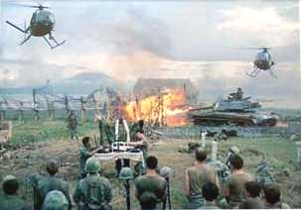
The Vietnam War 1954 - 1975

Slide 2
Vietnam War
The longest war in our history, it was the most reported and most visible to the public, but the least understood
-US General William Westmoreland

Slide 3
Background to the War
French Indochina
Japan took control during World War II
France attempted re-colonization in the postwar period
Notes:
*
Ho Chi Minh had been fighting for Vietnamese independence since World War I.
The U.S. gave France aid to win its support in American anticommunist efforts in Western Europe.

Slide 4
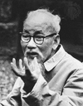
Background to the War
The French lost control to Ho Chi Minh’s Viet Minh forces in 1954
Eisenhower’s reaction
Notes:
*
Ho Chi Minh had been fighting for Vietnamese independence since World War I.
The U.S. gave France aid to win its support in American anticommunist efforts in Western Europe.

Slide 5
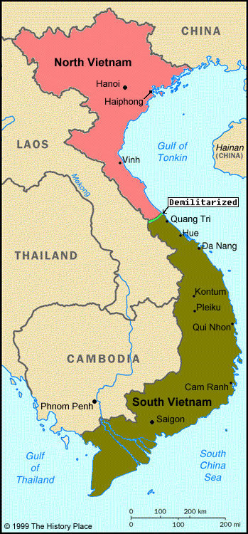
Peace conference (1954)
Divided Vietnam into North/South
Called for national elections in 1956

Slide 6
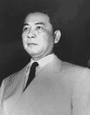
Background to the War
Ho Chi Minh’s communist forces controlled the North
Ngo Dinh Diem (French-educated Roman Catholic) controlled the South
Notes:
*
Realizing he would Diem backs out of elections.

Slide 7
U.S. Military Involvement Begins
Diem ruled as repressive dictator
Diem’s family held all power
Wealth hoarded by the elite
Buddhist majority persecuted
Torture, lack of political freedom
The U.S. aided Diem’s government. Why?
Domino Theory
Notes:
*
Realizing he would Diem backs out of elections.

Slide 8
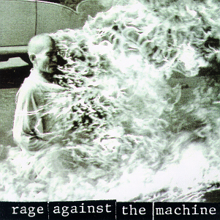
Diem attacked the Buddhists in South Vietnam
Monks began protesting the attacks in many ways including setting themselves on fire
US realized that Diem was a problem and had to be replaced

Slide 9
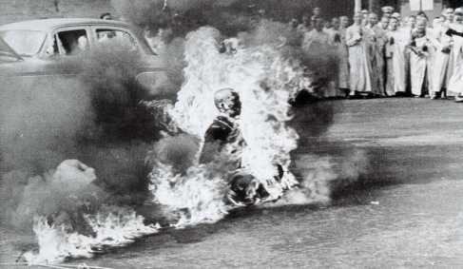
Early Protests of Diem’s Government
Self-Immolation by a Buddhist Monk

Slide 10
Vietcong -formed by 1960 in South Vietnam
Rebel communist group that fought Diem’s regime

Slide 11
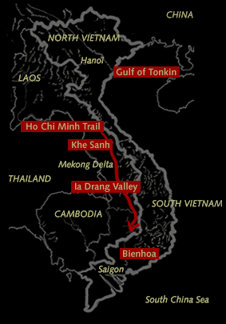
Ho Chi Minh Trail
a series of trails to supply the VC in South Vietnam
Weapons
other supplies

Slide 12
U.S. Military Involvement Begins
Kennedy elected 1960
1963:
JFK supports a Vietnamese military coup d’etat
Kennedy was assassinated just weeks later (Nov. 22)
Notes:
*

Slide 13
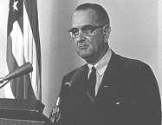
Johnson and Vietnam
Johnson was advised to increase US involvement by Secretary of State, Robert S. McNamara
“I’m not going to be the president who saw Southeast Asia go the way China went.”
Notes:
*

Slide 14
Gulf of Tonkin
August 1964: Gulf of Tonkin Incident
Leads to Gulf of Tonkin Resolution, 1964
Congress gave President power to defend American troops in Vietnam…President could “take all necessary measures” to protect US forces against attack
Allowed Johnson to send troops WITHOUT an official Congressional declaration of war
Notes:
*

Slide 15
The Ground War 1965-1968
The US believed that because of its superior military power, they would win…BUT!
Troops not used to the jungle terrain and guerrilla tactics
Ground war consisted of search and destroy missions:
measure success by body counts (on TV every night)
the VC began to set traps so when bodies were counted they would go off and hit US soldiers
GOODNIGHT SAIGON

Slide 16
The Air War 1965-1968
1965: Sustained bombing of North Vietnam
Operation Rolling Thunder (March 2, 1965)
Downed Pilots: P.O.W.s

Slide 17
Other than bombs
Napalm was dropped from planes
jelly-like gasoline that clung to flesh and burned; used to set fire to jungles
Agent Orange was a defoliant (killed plants)
used to destroy jungle cover used by guerillas
Affect on US troops?
ORANGE CRUSH!

Slide 18
AMERICAN TROOPS
Had superior weapons
Were unprepared for heat, terrain, or guerrilla tactics
Lacked support of most South Vietnamese
Most never saw the enemy but constantly faced the possibility of sudden danger.
GIMME SHELTER

Slide 19
Who Is the Enemy?
Vietcong:
Farmers by day; guerillas at night.
Support??
Patient people willing to accept many casualties.
US grossly underestimated their resolve and their resourcefulness.
The guerilla wins if he does not lose, the conventional army loses if it does not win. -- Mao Zedong

Slide 20
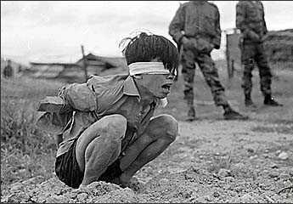
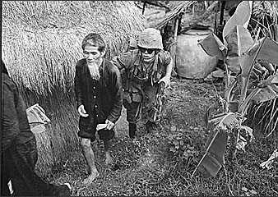
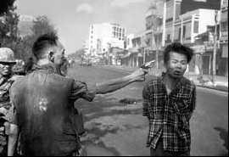
Who Is the Enemy?

Slide 21
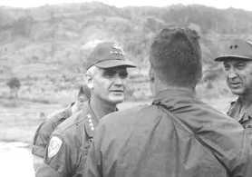
The Ground War 1965-1968
General Westmoreland
Commander of US military forces in Vietnam

Slide 22
WEAPONS
Land Mines
Saturation Bombing
Fragmentation Bombs
WAR

Slide 23
Morale Falls
As the war dragged on, morale fell among the troops in Vietnam
Statistics
Some soldiers “fragged” their commanders to keep from having to fight

