Slide 1
World War II

Slide 2



Axis Powers
Germany
Italy
Japan

Slide 3
Aggression Begins
Germany sends troops into Rhineland
Spanish Civil War 1936
  Nazis and Fascists help Franco fight against Nationalists
  Soviets help Nationalists against Franco

Slide 4
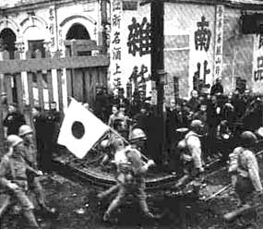
Japan Invades Manchuria (in China)

Slide 5
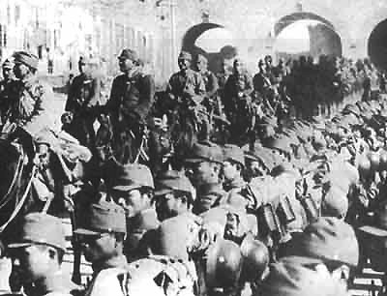
League of Nations does nothing

Slide 6
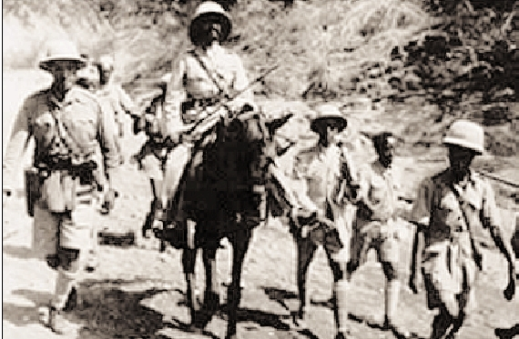
Italy Invades Ethiopia (1935)

Slide 7
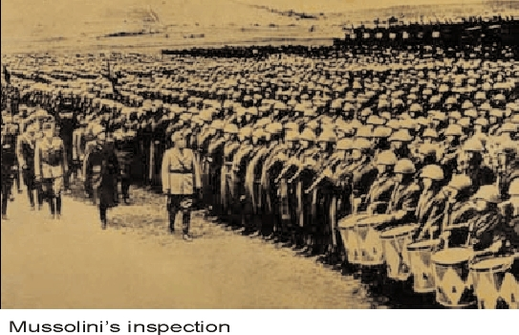
Italy Invades Ethiopia (1935)
League of Nations does nothing

Slide 8
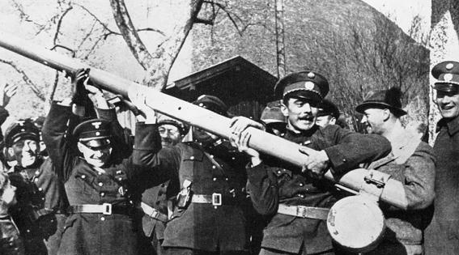
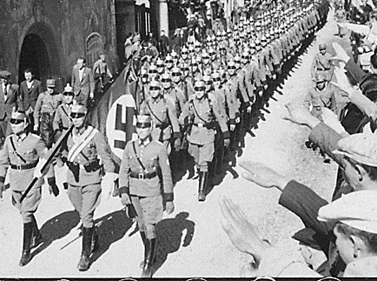
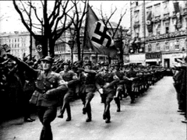
Anschluss
Hitler takes over Austria because Austrians share German culture

Slide 9
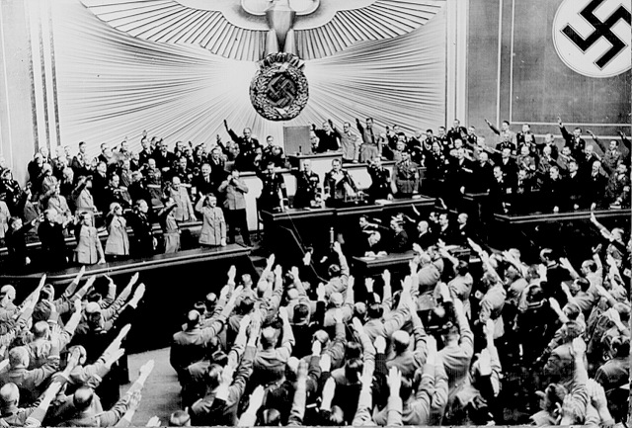
Anschluss
Hitler was welcomed by Germany as a hero for taking Austria
League of Nations does nothing

Slide 10
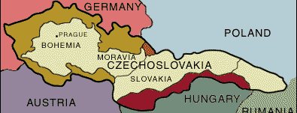
Sudetenland
Hitler demanded that Czechoslovakia give Sudetenland to Germany because it had Germans
Czechoslovakia wanted to fight
  Needed support of England and France

Slide 11
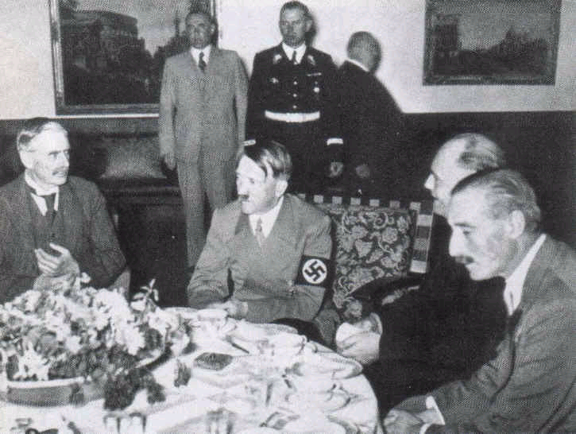
Munich Conference
England, Germany, Italy and France met to stop conflict over Sudetenland
Czechoslovakia was NOT invited

Slide 12
Munich Conference
England, France give Germany Sudetenland
Germany agrees to stop taking territories
  APPEASEMENT – giving into the demands of an aggressor to get peace

Slide 13
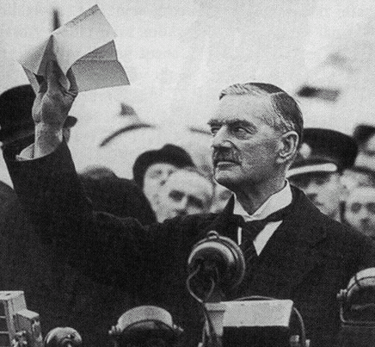
“Peace in Our Times”
Neville Chamberlain of England believed a major war was avoided

Slide 14
“Peace in Our Times”
Neville Chamberlain of England believed a major war was avoided
March 1939, Hitler takes over all of Czechoslovakia

Slide 15
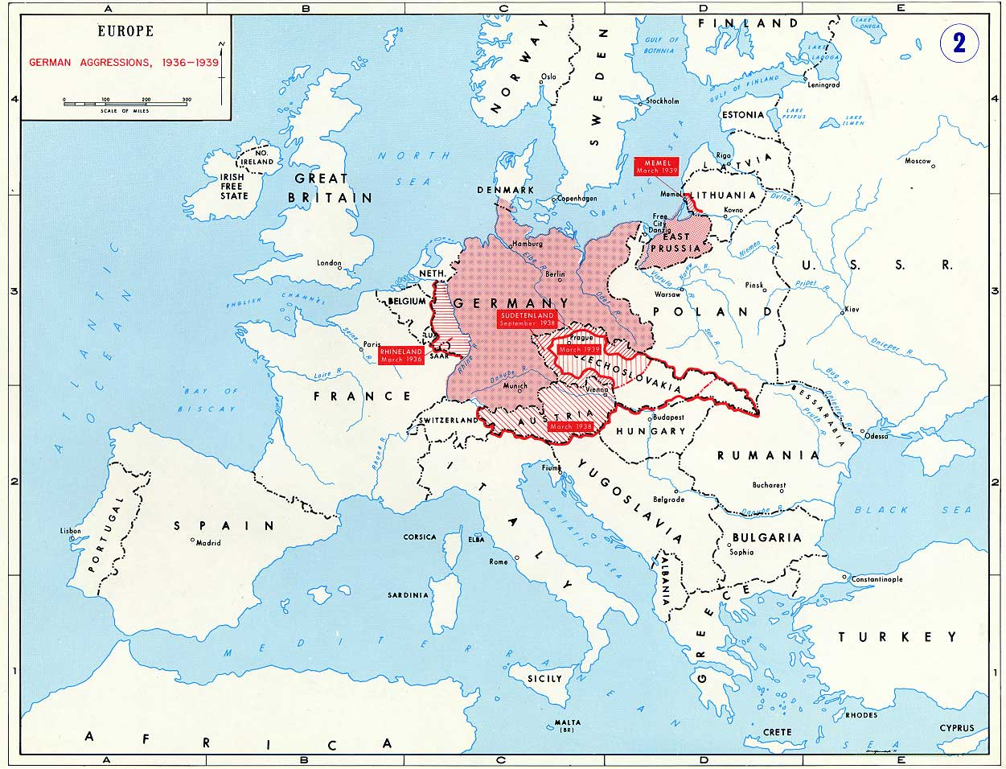

Slide 16
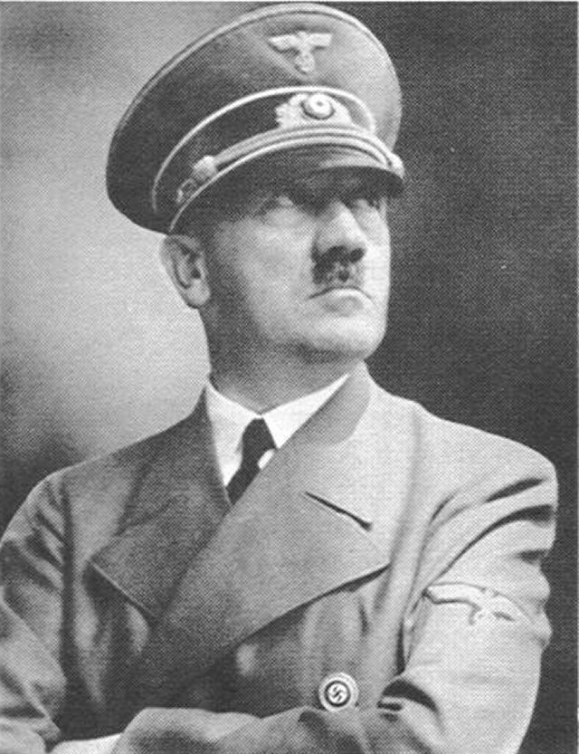
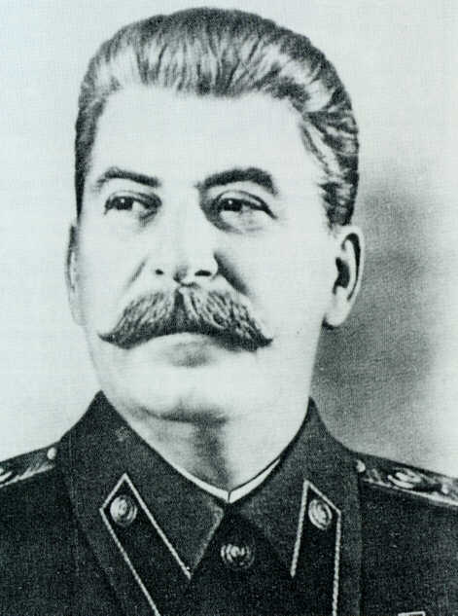
Nazi-Soviet Non-Aggression Pact
USSR and Germany agree not to fight each other
Secretly agree to divide Poland
Allows Germany to focus only on West

Slide 17
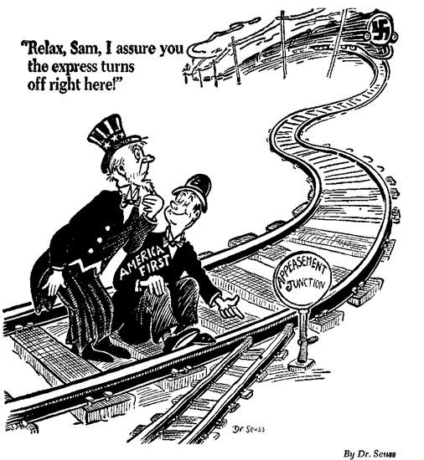
American Neutrality
Many Americans did not want to get involved in another European war
Neutrality Act (1935)
  Made it illegal to help any country fighting
FDR wanted to fight for England in Europe

Slide 18
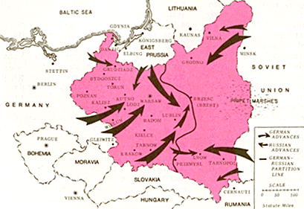
Invasion of Poland
September 1939
German Advance
Russian Advance
German - Russian Partition Line
England and France declare war against Germany in reaction to invasion of Poland

Slide 19
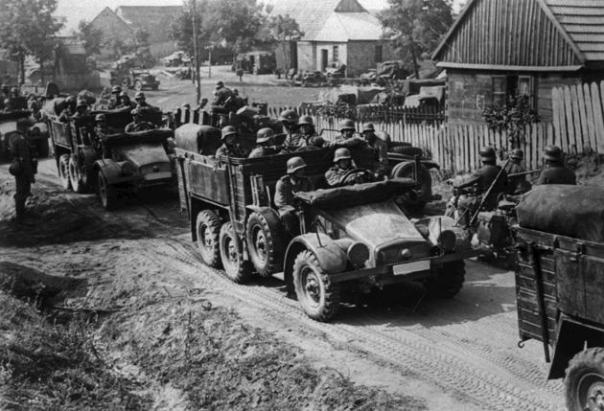
Blitzkreig – Lightning War
Modern Warfare that relied on speed, technology and overwhelming force

Slide 20
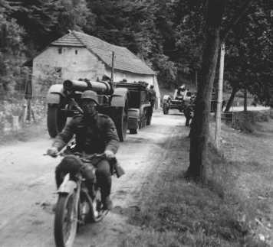
Blitzkreig – Lightning War
Modern Warfare that relied on speed, technology and overwhelming force

Slide 21
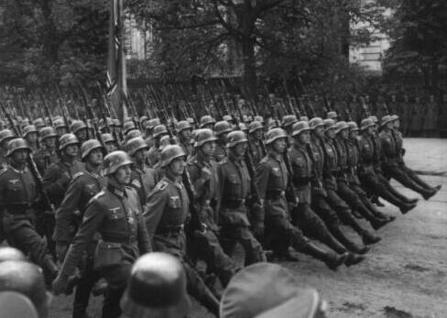
Blitzkreig – Lightning War
Modern Warfare that relied on speed, technology and overwhelming force

Slide 22
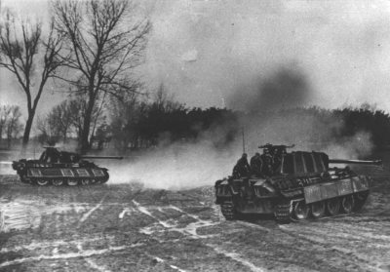
Blitzkreig – Lightning War
Modern Warfare that relied on speed, technology and overwhelming force

Slide 23
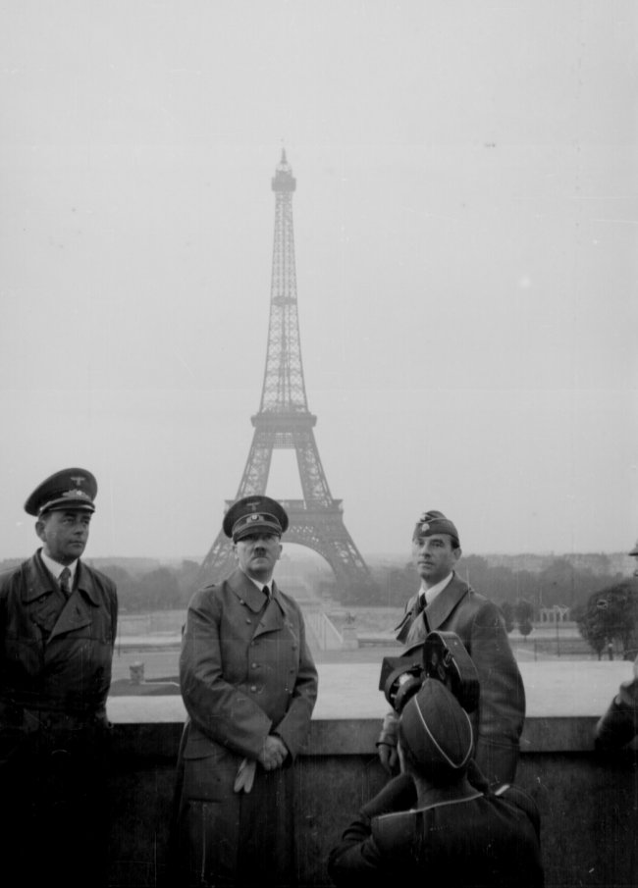
Axis Victories
May 15
  Holland Surrenders

Slide 24
Axis Victories
May 15
  Holland Surrenders
May 28
  Belgium Surrenders

Slide 25
Axis Victories
May 15
  Holland Surrenders
May 28
  Belgium Surrenders
June 10
  Norway surrenders

Slide 26
Axis Victories
May 15
  Holland Surrenders
May 28
  Belgium Surrenders
June 10
  Norway surrenders
June 22
  France surrenders

Slide 27
Axis Victories
May 15
  Holland Surrenders
May 28
  Belgium Surrenders
June 10
  Norway surrenders
June 22
  France surrenders
July 10
  Battle of Britain begins

Slide 28
Axis Victories
May 15
  Holland Surrenders
May 28
  Belgium Surrenders
June 10
  Norway surrenders
June 22
  France surrenders
July 10
  Battle of Britain begins
Nov 20
  Hungary joins Axis

Slide 29
Axis Victories
May 15
  Holland Surrenders
May 28
  Belgium Surrenders
June 10
  Norway Surrenders
June 22
  France surrenders
July 10
  Battle of Britain begins
Nov 20
  Hungary joins Axis
Nov 23
  Romania joins Axis

Slide 30
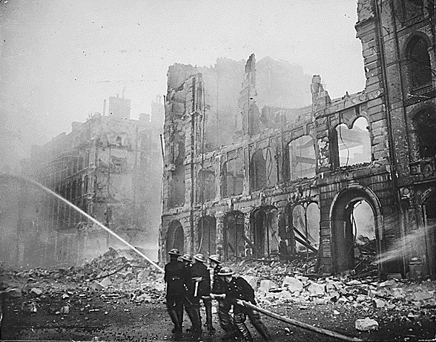
Battle of Britain – London Blitz
Hitler bombs London 60 days in a row

Slide 31
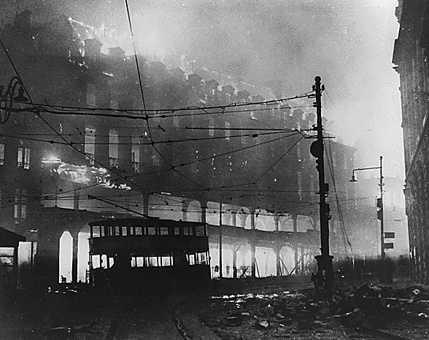
Battle of Britain – London Blitz
Hitler bombs London 60 days in a row

Slide 32
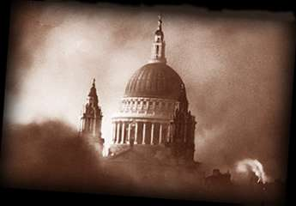
Battle of Britain – London Blitz
St Paul’s Cathedral
Symbolized British refusal to be beaten
Hitler bombs London 60 days in a row

Slide 33
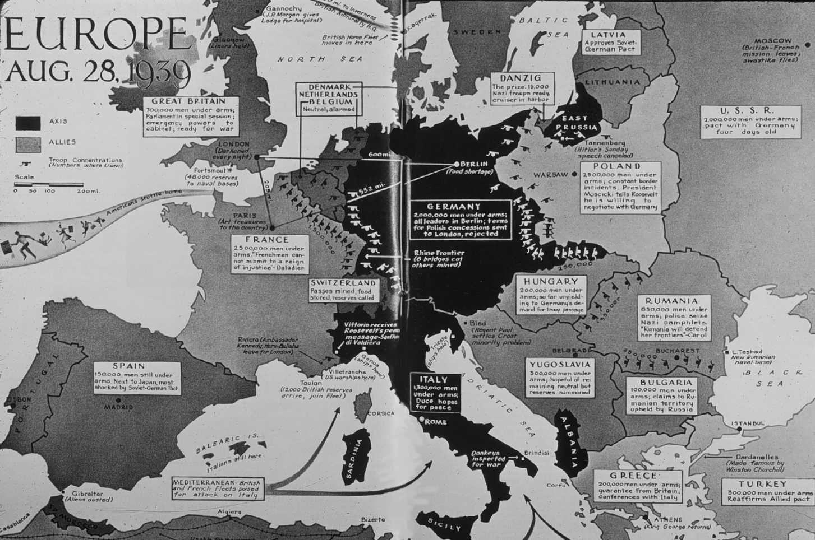
Europe Before Axis Invasions (September 1939)

Slide 34
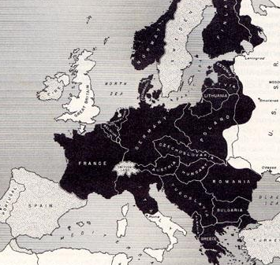
Europe After Axis
Invasions (November 1940)

Slide 35
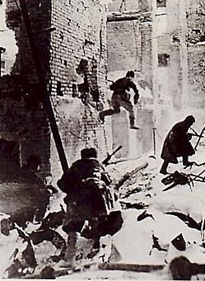
Soviet Union at War
Operation Barbarossa
  Germany’s plan to invade Soviet Union
  Soviets retreat and practice scorched earth
Battle of Stalingrad
  Nov 1942-Feb 1943
  Soviets defeat Nazis – turning point of war

Slide 36
