Slide 1
World War I

Slide 2
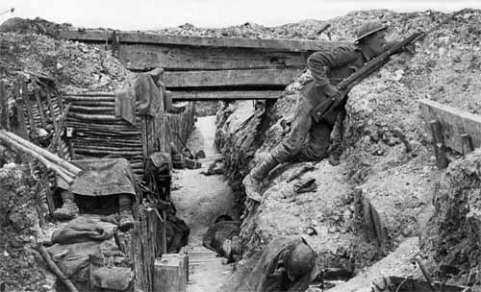
Basics
Who?
Allied Powers
Great Britain, France, Russia
Japan, Italy, and the United States joined later while Russia left
Central Powers
Germany, Austria-Hungary, Ottoman Empire
When?
Started in 1914, peace treaty in 1919
Why?
MAIN
Where?
Mainly Europe along the Western and Eastern Fronts

Slide 3
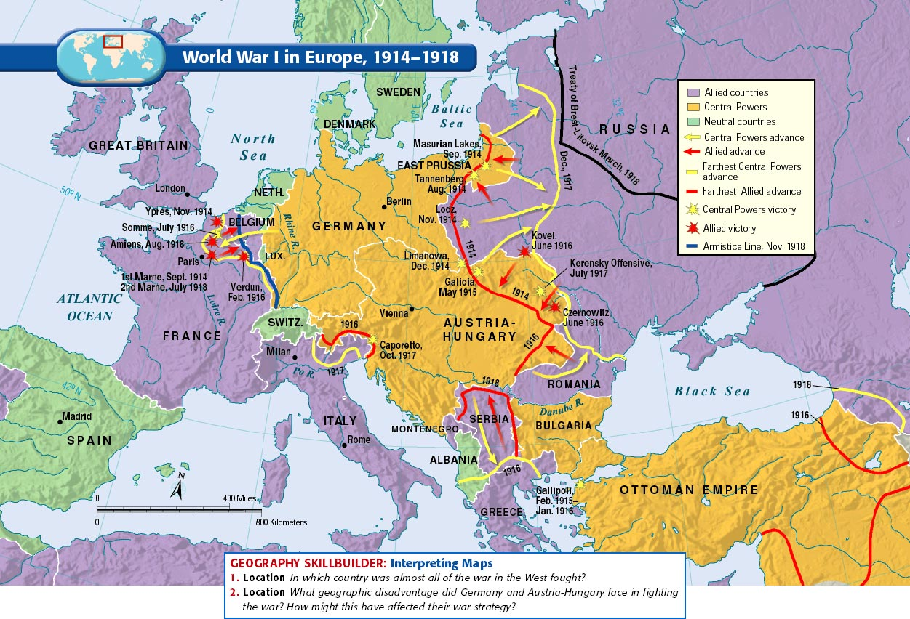

Slide 4
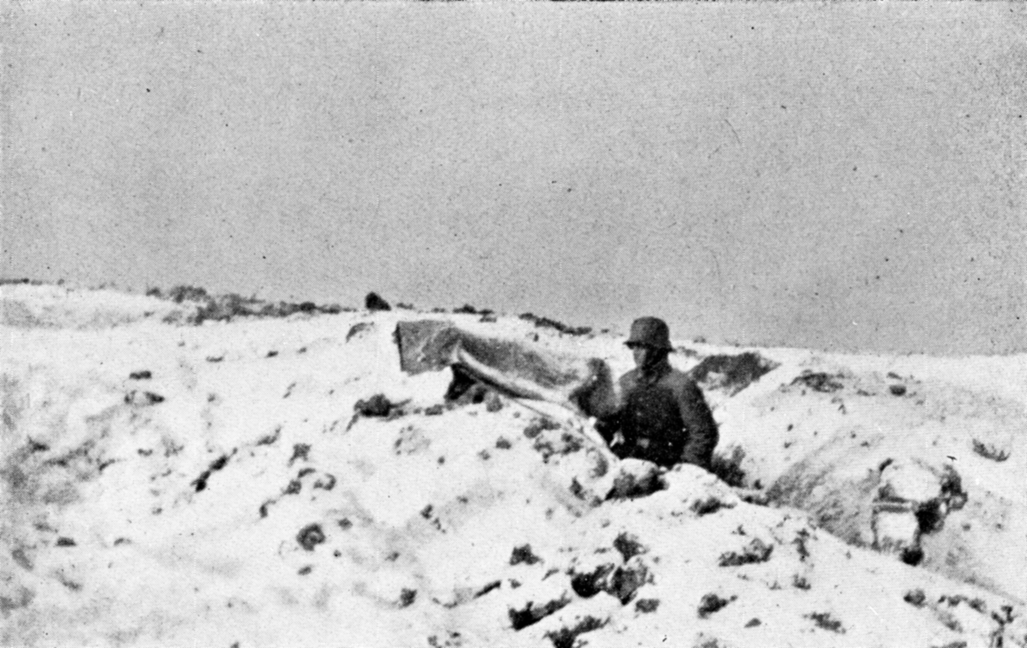
Warfare
Mainly fought between trenches on the Western (France) and Eastern (Russian) Fronts
West- “terrain of death”, East- “frozen front”
Trench warfare resulted in massive death tolls, limited change of land possession
Life in trenches was miserable, no-man’s-land outside of it was worse
Attrition- constant sustained attacks
Military strategists at a loss
New technology=more death
Poison gas, machine guns, tanks, subs
WWI was total war
Countries devote all resources to war effort, governments took control of economy
Rationing, propaganda, women pressed into working roles

Slide 5
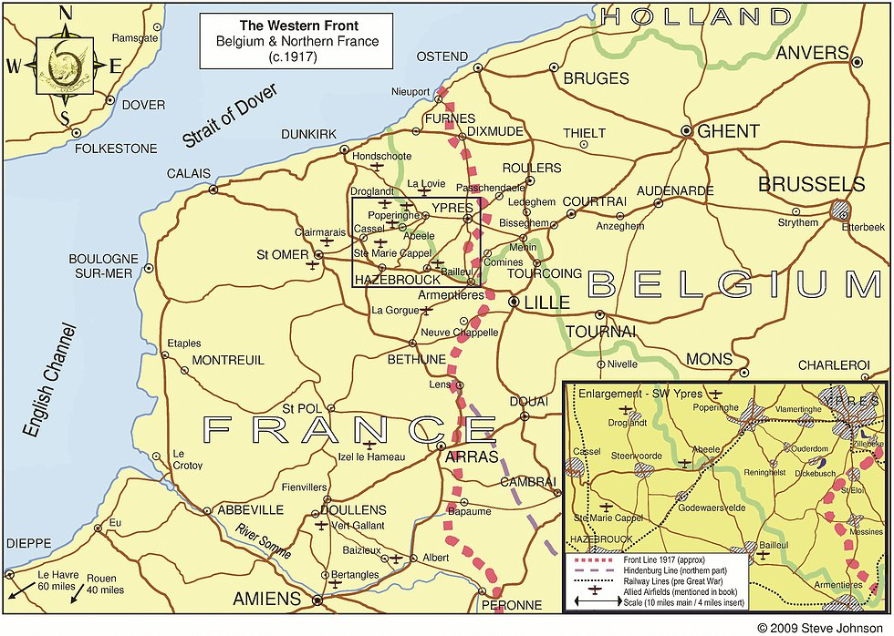
Battles/Conflicts
Thru 1917
Western Front
1914- First Battle of the Marne
General Schlieffen wanted to quickly destroy France, then focus on Russia (known to be unorganized and slower), Schlieffen Plan
French rally outside of Paris led to Allied victory, future stalemate
1916- Battle of Verdun
Allies repelled German offensive
Both sides with over 300k casualties
1916- Battle of Somme
French and British offensive that the Germans repelled
Minimal Allied gains, over 500k casualties

Slide 6
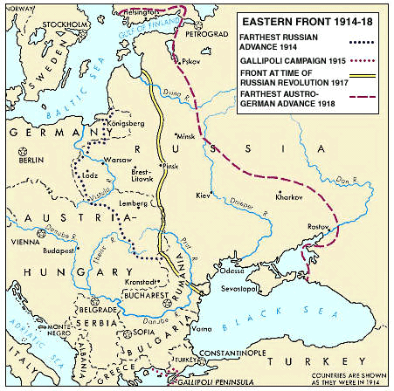
Battle/Conflicts
Thru 1917
Eastern Front
Mainly Russia/Serbia vs. Germany/Austria-Hungary
Russian Army
Huge numbers- constant reinforcements
Russia is not industrialized and German control of Baltic limited Allied support
By the end, Russian soldiers and people doubt the czar and government
1914- Battle of Tannenberg
Russian offensive destroyed by German counterattack
1917- Kerensky Offensive
Last chance Russian offensive
Internal collapse after initial success, led to defeat

