Slide 1
A ‘World War’

Slide 2
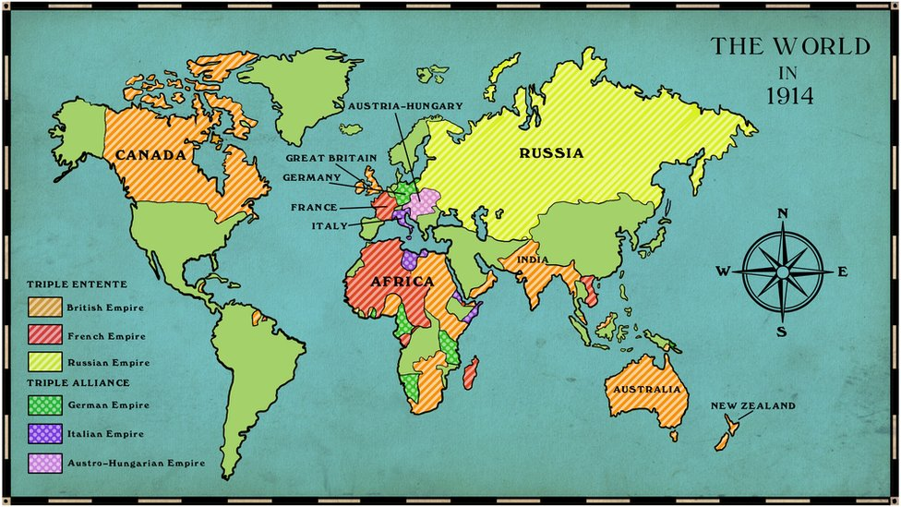
A ‘World’ War
“Terrain of death” (Western) and “front front” (Eastern) were significant parts of a WORLD war
Stalemates in the trenches led Allies and Central Powers to look elsewhere for victory
Both sides look for global participants to take war else
Did not do much to end the slow, painful conflict

Slide 3
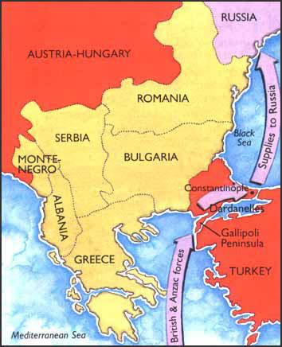
Southern Front
Gallipoli Campaign- failed Allied offensive
Allies looked to attack Ottoman region known as Dardanelles
Gateway to Constantinople
Cut off Ottomans, supply the Russians
GB, AUS, NZ, F vs. OE, G
Unplanned trench warfare from Feb to Dec 1915

Slide 4
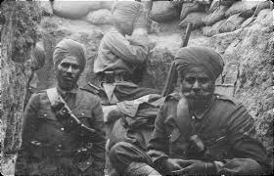
The Colonies
Many European countries have imperial possessions throughout Africa and Asia
Germany loses territories
Japan attacks and seizes German possessions in Pacific
Great Britain and France take ___ in Africa
Colonial troops
Great Britain and France recruit
Indian troops fought and supplied British forces while Algerian and Asian (Indochina) troops assisted the French… TOTAL WARFARE

Slide 5
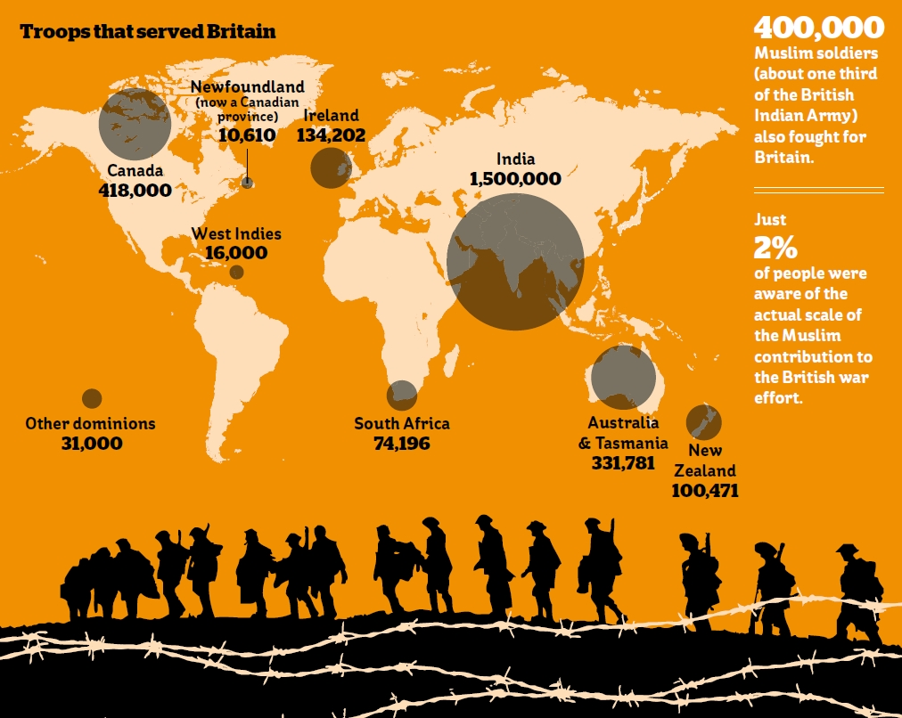

Slide 6
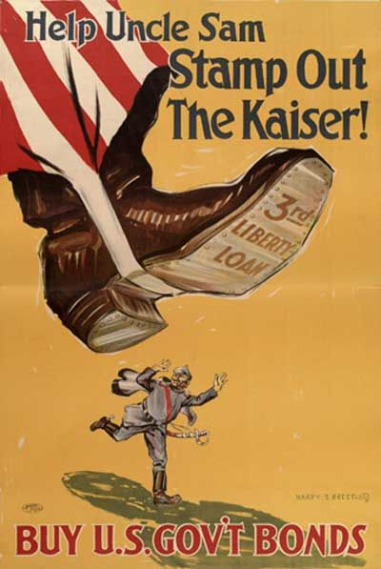
1917 Turning Point-
United States
American Entry
Unrestricted submarine warfare and German U-Boats
Lusitania- 128 U.S. citizens
Zimmerman Telegram
Already helping Allies, bond w/ England, officially declare war on Germany in April 1917
FRESH AMERICAN TROOPS!

Slide 7
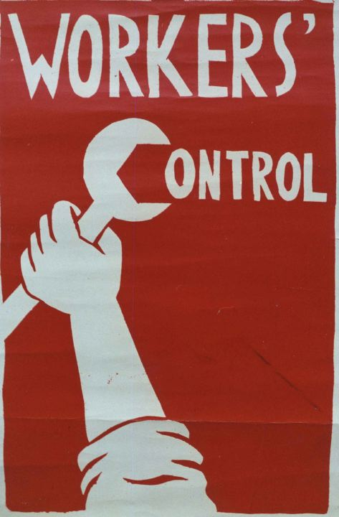
1917 Turning
Point- Russia
War-related problems plague Russia
Attrition and soldiers, food and fuel shortages
March 1917- Czar Nicholas stepped down, provision gov’t set up
Kept fighting, losing army support
Revolution culminates in Vladimir Lenin’s seizure of power in Oct/Nov 1917
Russians want OUT of war
Lenin promises to end it when he gains power
March 1918- Treaty of Brest-Litovsk ends war with Germany
Germany has some hope… One front war!

