Slide 1
End of WWI

Slide 2
Review of Thursday/Friday

Slide 3
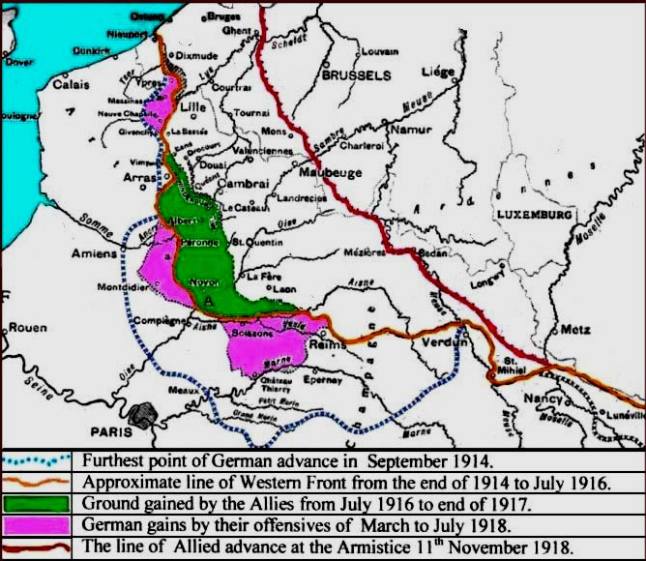
Collapse of the
Central Powers
Second Battle of the Marne (1918)
Final German offensive (think Lost Battalion) in France
40 miles away from Paris
Weakened army + 2 million fresh Americans = Allied victory
Central Powers surrender
Ottomans surrender with Bulgarians
Revolution in October removes Austria-Hungary
German soldiers mutiny and German people turn on Kaiser Wilhelm

Slide 4
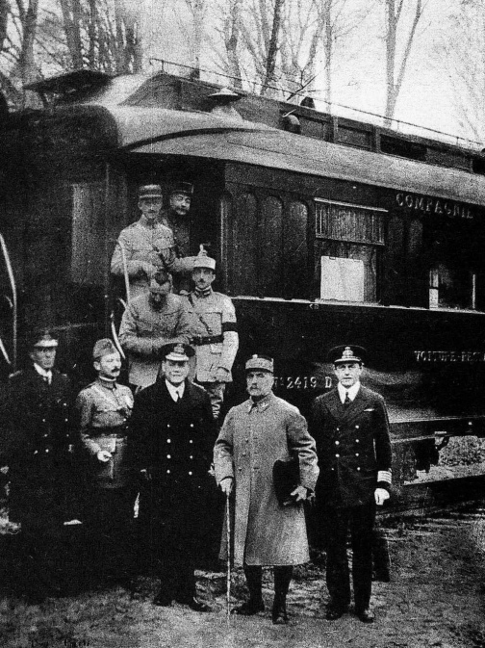
Armistice of 11 November 1918
Armistice- formal agreement to stop fighting
“Eleventh hour of the eleventh day of the eleventh month”
Inspired by Wilson’s 14 Points
Signed in a French railcar by German politicians
Allies would occupy the Rhineland
End of military hostilities
Removal of German troops from fronts
Surrender of U-Boats and war materials
Release of Allied POWs, German ones to be released after peace treaty

Slide 5
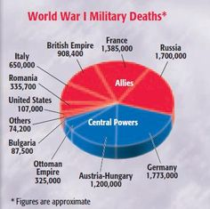
Legacy of WWI
Total global warfare led to extreme death and destruction
About 17 million dead and 20 million wounded
Civilians and soldiers, battlefield and hospitals, all countries
Economic drain on resources
Treasuries of many countries ruined
Approx. $400 billion cost of war
Farmland, towns, cities destroyed as well
What next???
Armistice is NOT a peace treaty
What should Allies do with defeated Central Powers?

Slide 6
Woodrow Wilson’s
14 Points
Wilson drew up 14 Points in 1918 (war still raging)
Content of Treaty
1-4: end secret treaties, free seas, free trade, reduce armies
5: fairness to colonies
6-13: New borders, self-determination
14: League of Nations- International peacekeeping organization
In general, he wanted peace for all countries, NOT looking for revenge!
Final Treaty of Versailles was rejected by Wilson
United States did NOT join the League
Stay out of world affairs
Republicans stick it to Wilson

Slide 7
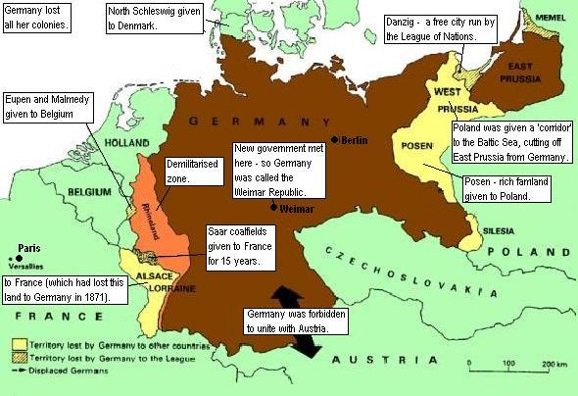
Treaty of Versailles
Paris Peace Conference in January 1919
Big 4 with no representation for Russia, Germany, and Central Powers
US wanted peace, GB and F wanted revenge
Final results in June 1919 (BRAT)
Germany had to accept the Blame, war-guilt clause
Germany had to pay Reparations for war damage
Germany could not have subs, air force and limited army/navy
Germany lost Territory and mandates were given to Allies by League of Nations

