Slide 1
Russian Revolution- The Lenin Era

Slide 2
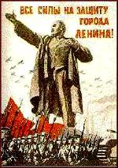
Vladimir Ilyich Lenin
“Father of the Revolution”
Brother killed for plotting to kill czar
Engaging personality, excellent organizer, brilliant thinker
Fled to Western Europe during early 1900s to avoid pressure from Czar
Led the Bolshevik Party from afar
Ultimately led Bolshevik Revolution in 1917
“Peace, Land, and Bread”

Slide 3
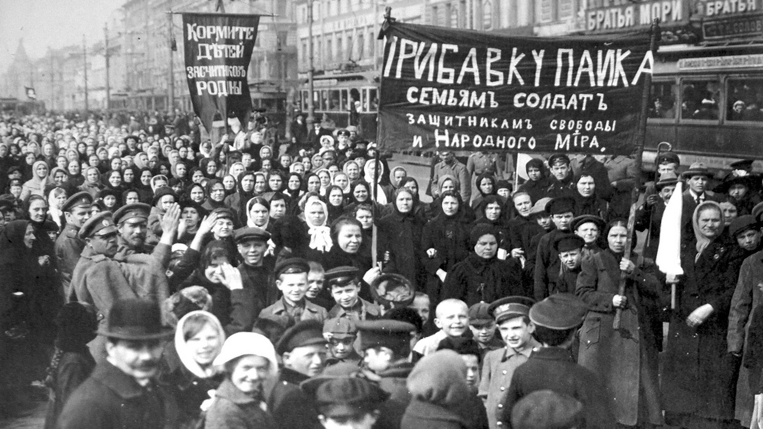
The March Revolution (1917)
Inspired by women textile worker strike in Petrograd
Soldiers shot at then sided with strikers
Czar Nicholas II forced to abdicate throne
Executed with family in 1918
End of Romanov dynasty that ruled for three centuries
Duma set up provisional government
Alexander Kerensky in charge
Weak gov’t that kept country in war
Soviets- local governments
Germany arranged for Lenin’s return

Slide 4
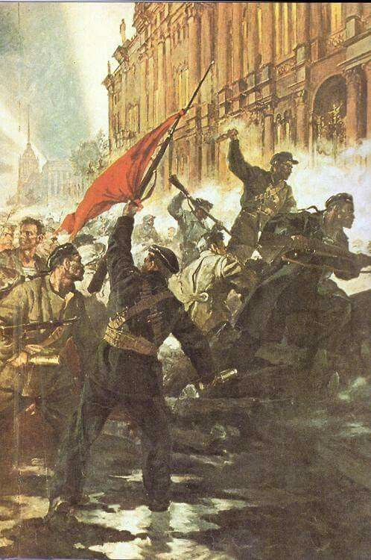
The Bolshevik Revolution
Gained control of the Petrograd soviet
“All power to the soviets” and “Peace, Land, and Bread”
Lenin took action in November 1917
Bolshevik Red Guards storm Winter Palace
Arrested provisional gov’t, Kerensky fled
Immediate Action
Farmland to peasants, factories to workers
Treaty of Brest-Litovsk- weak for Russia, people upset
Need to remove threats at home

Slide 5
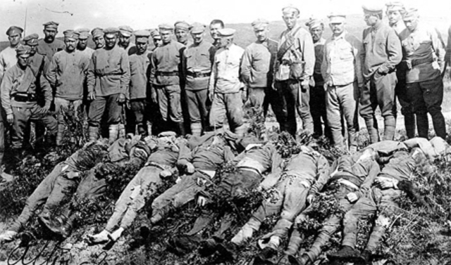
Civil War in Russia
Bolsheviks enemy- White Army
Diverse in beliefs, unorganized
Civil war occurred from 1918-1921
Western nations tried to help the White Army, little success
Leon Trotsky- commanded the Bolshevik Army
14 million deaths
Famine and flu
Won by the Red Army
Ultimately destroyed existing political and social structure
State-controlled gov’t/society

Slide 6
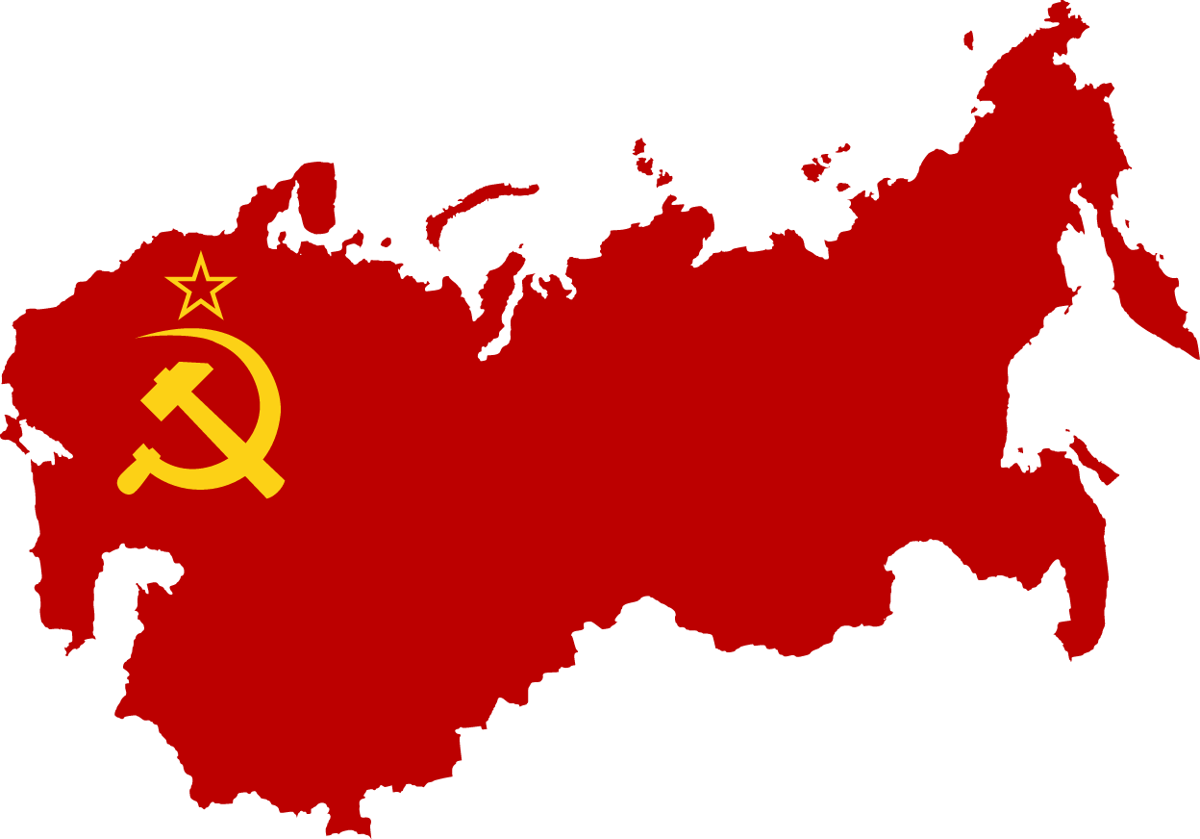
Lenin’s Russia
New Economic Policy
Meant to fix the broken economy
State-controlled major industries
Farmers could sell surplus and some factories were private
Dangers of nationalism
Wanted to keep it in check
Central government with smaller self-governing republics underneath
Bolsheviks became Communist Party
Classless society- Karl Marx
Russia became the United Soviet Socialist Republics (USSR)

