Slide 1
Russian Revolution-
Stalin Era

Slide 2
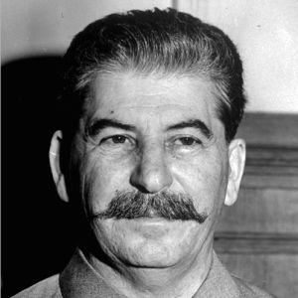
Josef Stalin
“Man of steel”
Rose rapidly within Bolshevik Party
From General Secretary in 1922 to total command in 1928
Cold, ruthless, and impersonal
“I am not sure that he always knows how to use that power with sufficient caution”- Lenin
Exiled his competition, Leon Trotsky

