Slide 1
Japan and Early WWII
https://www.youtube.com/watch?v=kzH1iaKVsBM
https://www.youtube.com/watch?v=BlUld1yXKRo

Slide 2
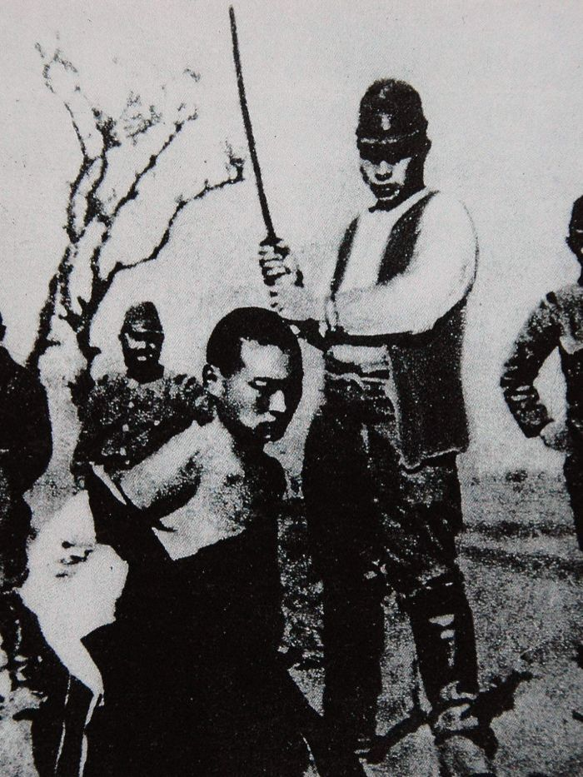
Immediately Before the War
China
Invaded Manchuria, then much of China
War with China- civil war suspended
Rape of Nanking
Southeast Asia
Southern Expansion Doctrine (1936)
Took French Indochina, America cut oil exports
Leadership
Hirohito- Emperor
Hideki Tojo- Military leader
Admiral Isoroku Yamamoto- Pearl Harbor
Tripartite Pact w/Germany and Italy
“establish and maintain a new order”

Slide 3
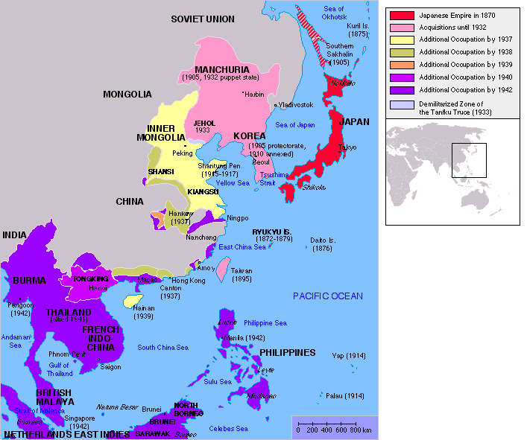

Slide 4
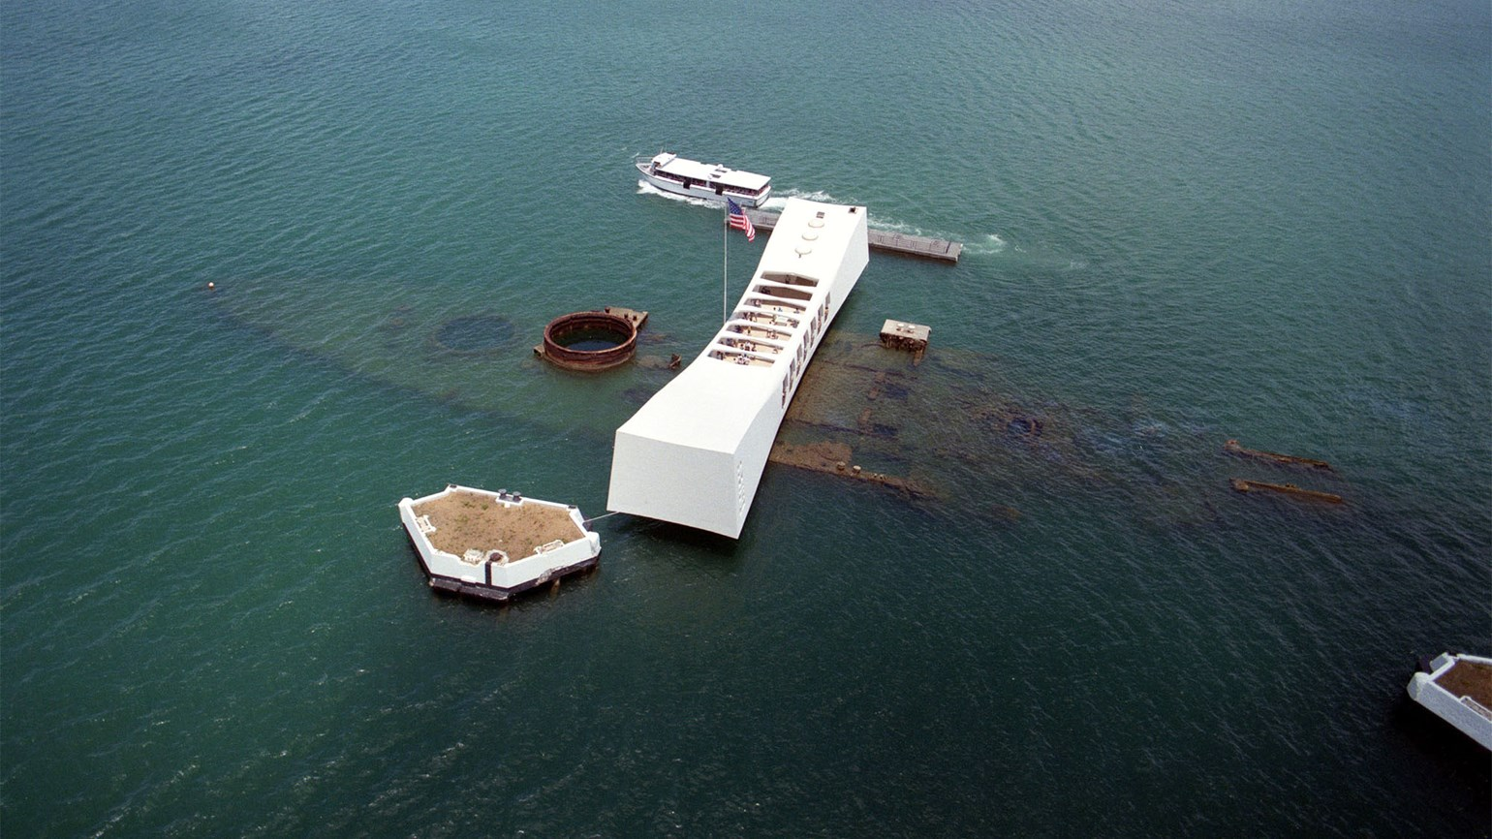
Attack on Pearl Harbor
“A date which will live in infamy”- December 7, 1941
Threat of strategic US navy in Hawaii
Day of attack
US officials cracked code, had an idea
19 ships, 8 battleships destroyed
3400 casualties
Simultaneous attacks
Hong Kong- GB
Guam and Wake Island- US
Push for Japanese empire

Slide 5
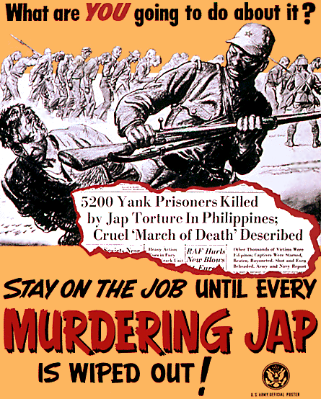
Early Japanese
Successes
Late 1941/Early 1942
U.S.- Wake Island and Guam
Philippines- Bataan Peninsula
British- Hong Kong, Singapore, East Indies, planned for India
“East Asia for the Asiatics”
Unite Asians against colonial powers
Asians recognized Japanese were conquerors
Bataan Death March
Japanese war crime
Tansport of approx 80,000 Filipino and American POWs
Brutal treatment led to thousands of casualties over 3 months

Slide 6
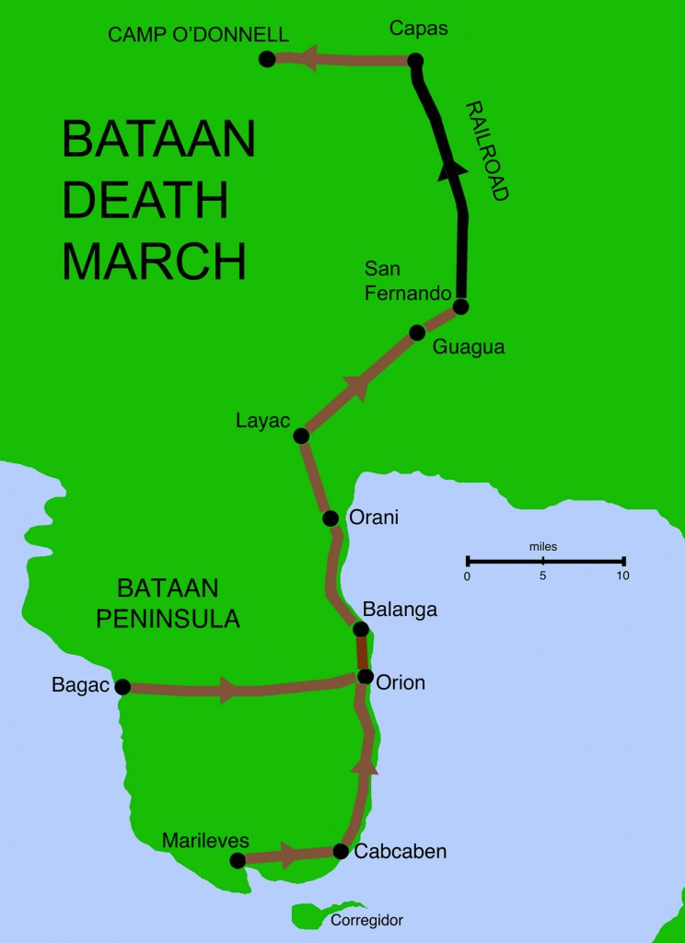

Slide 7
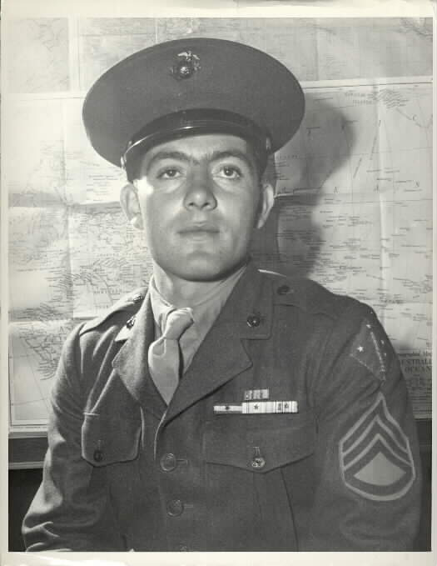
The Allies Strike Back
American response
Lieutenant Colonel Doolittle bombed Tokyo in April 1942
Create doubt
Battle of the Coral Sea
New aerial warfare
Allied casualties, but halted Japan's advance
Battle of Midway
Turned the tide of the Pacific war
Code breakers knew Yamamoto was planning attack
Allied Offensive
General MacArthur and island-hopping
6 months of fighting resulted in American victory at Guadalcanal

