Slide 1
Economic Trouble
Leads to Fascism

Slide 2
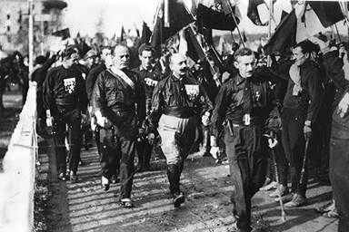
Fascism in Italy
Need for a change
  Treaty of Versailles was unfavorable
  Inflation and unemployment
  Disappointment in democracy
Benito Mussolini
  Editor and politician- Fascist Party in 1919
  March on Rome in 1922- removed King
  Known as ‘Il Duce’- The Leader
  Removed democracy, state control of media
  Gov’t allied with industrialists and landowners
  Blackshirts- Militia for National Security
    Authoritative police that work for Mussolini

Slide 3
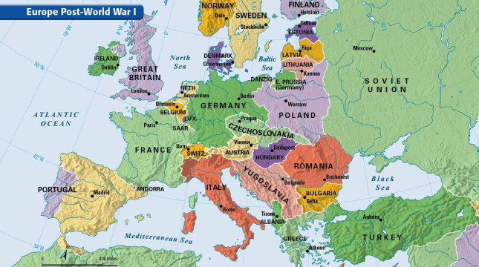

Slide 4
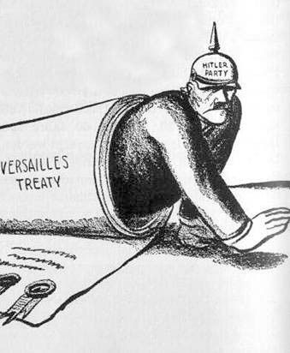
Post-WWI Europe
Economic problems after the war
  Debt and inflation
Unstable democracies led to fascism
  Fascism- militant political movement that emphasized loyalty to state and leader, usually favored a specific group
  Extreme nationalism
  Main difference from communism- each class has specific purpose
Broken Germany needs leadership
Great Depression hinders recovery

Slide 5
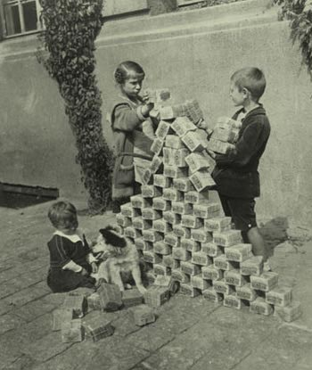

The Weimar
Republic
BRAT and the Treaty of Versailles
Democratic government was unsuccessful
Inflation to pay off wartime costs
  Did not raise taxes during war, printed money after, money had no value
Dawes Plan
  American plan to help Germany pay reparations
  US---Germany---Allies---US
  Great Depression ruined this system
    Impacted the entire world

Slide 6
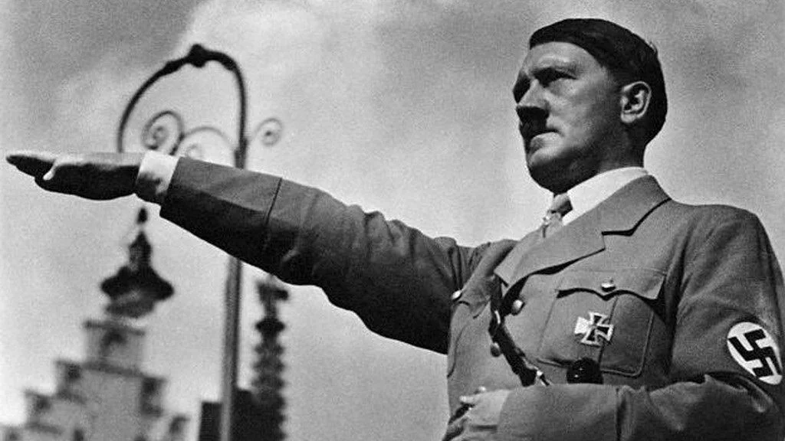
Rise of Hitler
Born in Austria in April 1889
Artist, soldier, politician
Resented German surrender
Believed there was a Jewish conspiracy in Germany
  Jewish politicians and professionals were responsible
Joined German Worker’s Party, which turned into the Nazi Party
  Revoke the Treaty of Versailles
  Revoke Jewish Civil Rights
  Return Germany to power

Slide 7
https://www.youtube.com/watch?v=lTQ4TILv3RQ&t=251s
Why did Adolf Hitler and the Nazi Party leave many Germans feeling “electrified”?

