Slide 1
Yalta and Potsdam Conferences

Slide 2
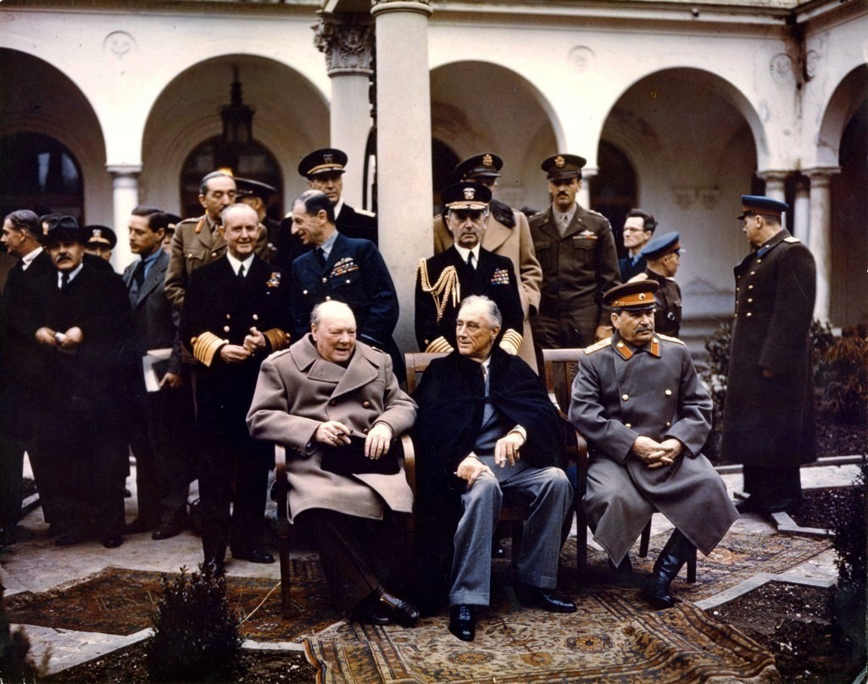
Yalta Conference
(February 1945)
“Big Three” (Churchill of England, Roosevelt of USA, Stalin of USSR)
Key topics
Unconditional surrender of Axis Powers
United Nations to keep peace after war
Russia declare war on Japan (& help USA invade Japan) after Germany surrendered
Divide Austria, Germany & capital Berlin into 4 occupied zones
Self-determination in Eastern Europe
Stalin allowed reluctantly, wanted part of Poland

Slide 3
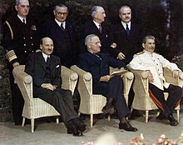
Potsdam Conference
(July/Aug 1945)
Stalin/Churchill & Atlee/Truman
Stalin pressured Eastern European countries to become communist
Truman unhappy with these new pro-Soviet governments; demanded Stalin allow free elections, Stalin refused
Stalin feared they would be anti-Soviet
Atomic Bomb
‘Potsdam Declaration’- gave Japan ultimatum: unconditionally surrender or face "prompt and utter destruction"

