Slide 1
Asian Empires Review

Slide 2
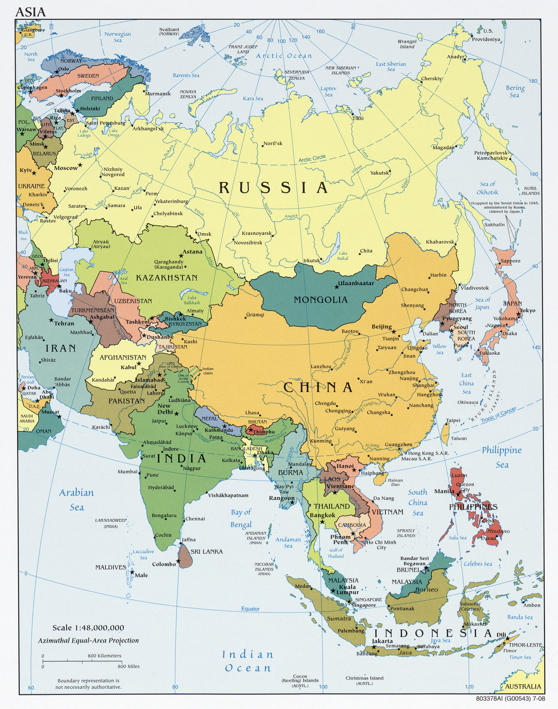
Map

Slide 3
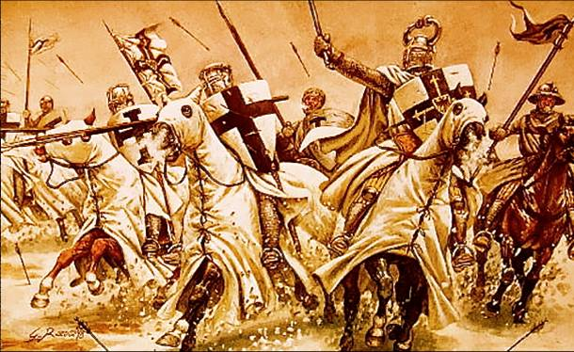
19.1 (4)
Crusades
Is it offensive?
Susquehanna University
Maranatha Baptist University

Slide 4
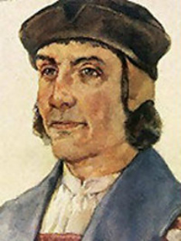
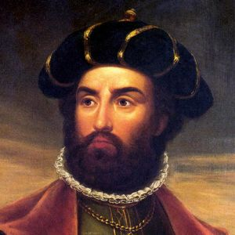
19.1 (7)
Explorers

Slide 5
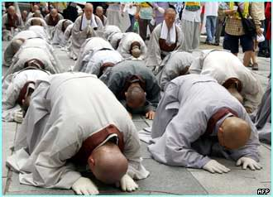
19.2 (7 & 8)
Kowtow
George Maccartney

Slide 6
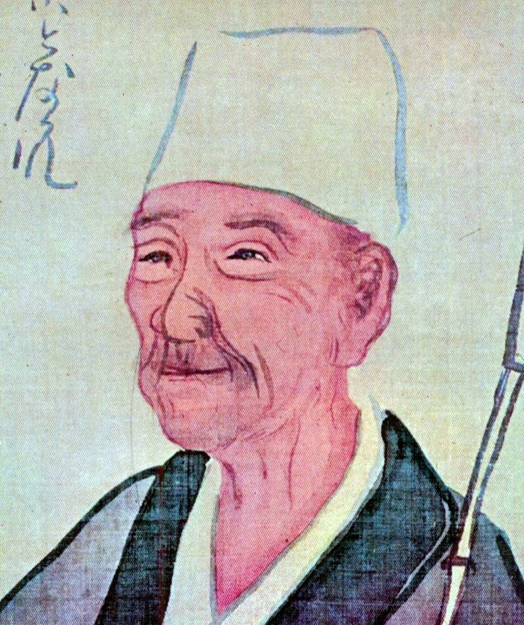
19.3 (2)
Matsuo Basho

Slide 7
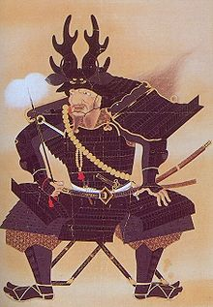
19.3 (8 & 10)
Tokugawa Shogunate
Samurai/Daimyo

