Slide 1
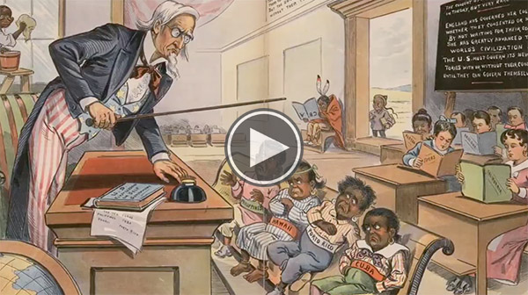

Slide 2
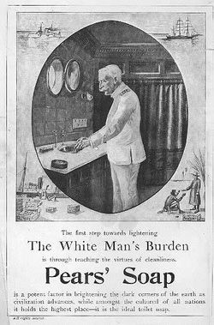
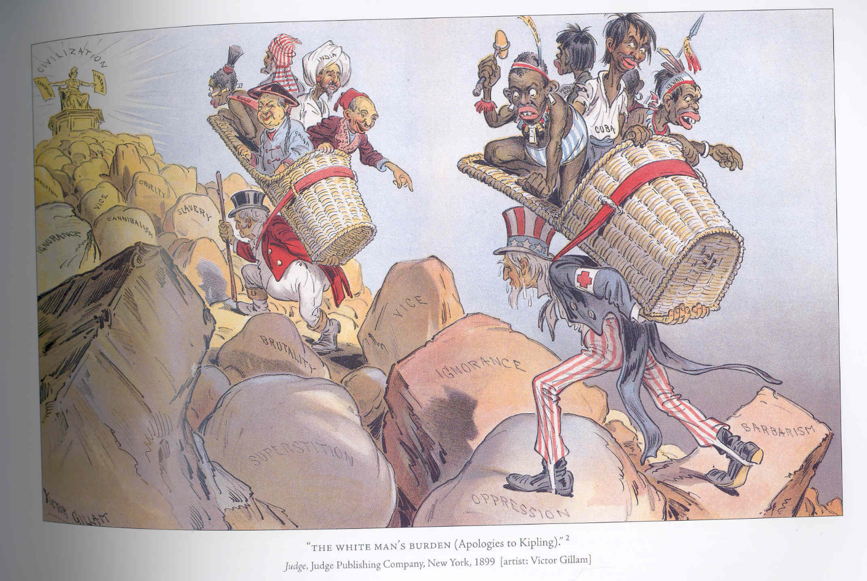
“White Man’s Burden”
Rudyard Kipling
Philippine American War
Exhorts imperialism
Industrialization of the world civilizes the 3rd world
Belief needed to civilize “half devil half child natives
“The first step towards lightening The White Man’s Burden is through teaching the virtues of cleanliness.”
Notes:
Perhaps flash back to the white man’s burden cartoon

Slide 3
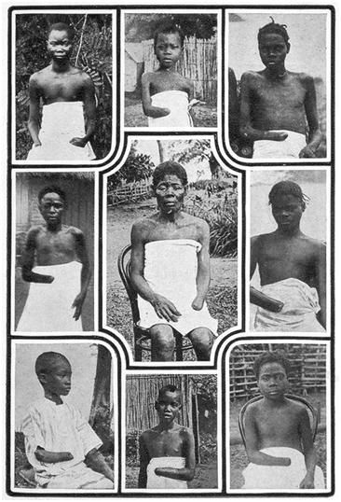
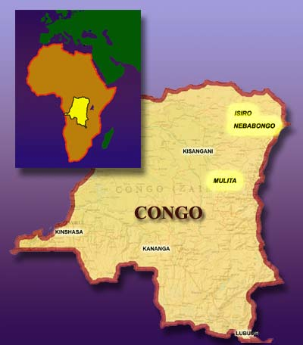
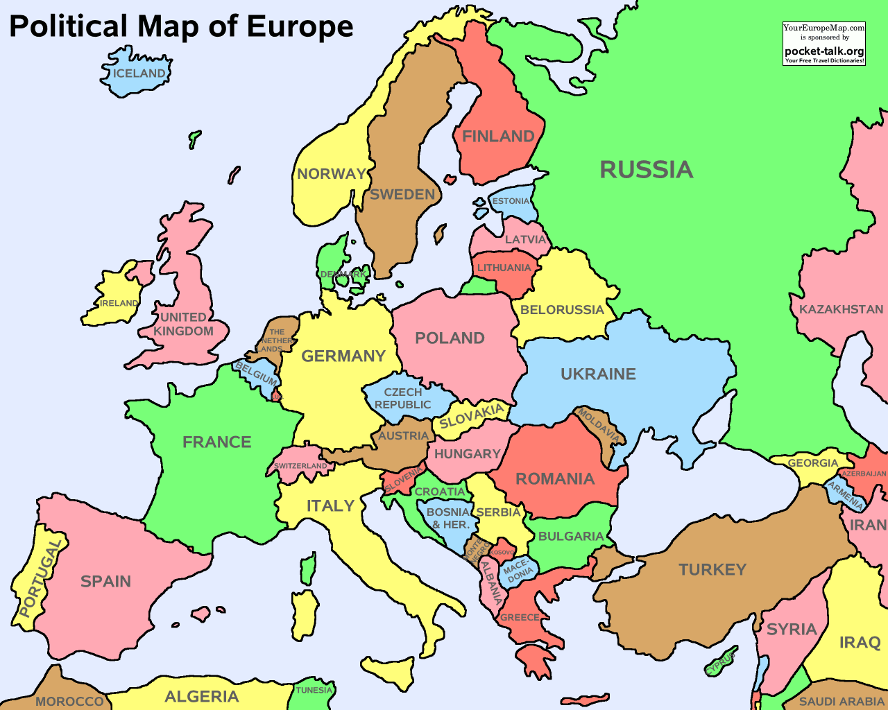
Belgium Congo
Congo – 905,000 sq. miles
Belgium – 76X bigger
King Leopold
-International African Association – westernization and missionary work
-The Butcher
-ruled 23 years
-richest man in the world
-death and mutilation of 10 million

Slide 4
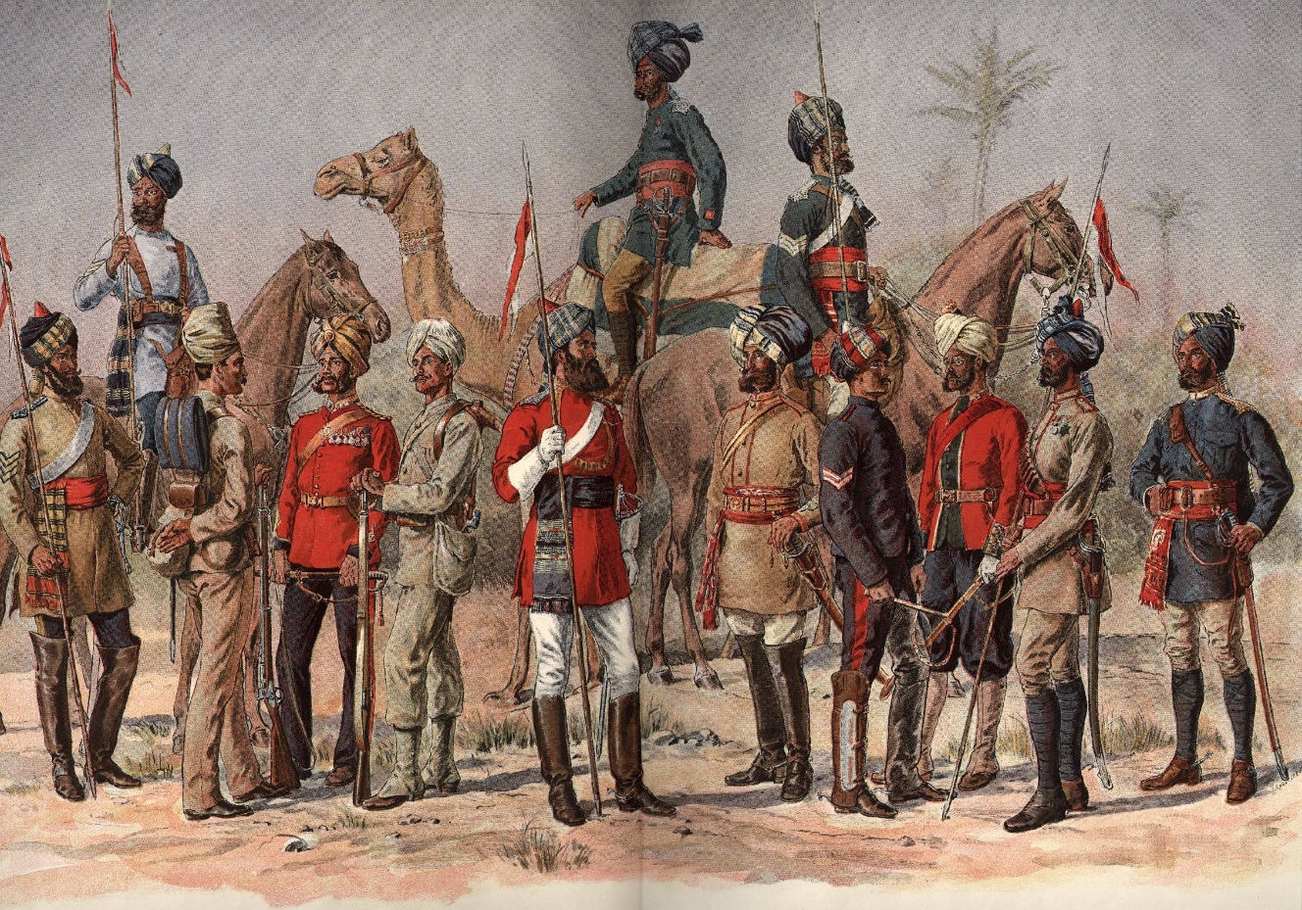
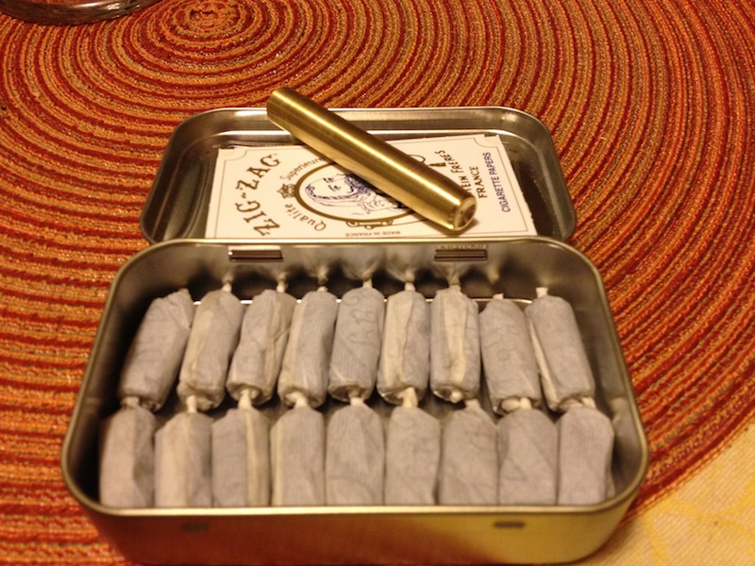
Sepoy Rebellion
British East India Co. & Army
Hindus Majority vs. Muslims Minority
Pork\Beef gun powder cartridges
British government intervention
End of Mughal Empire

Slide 5
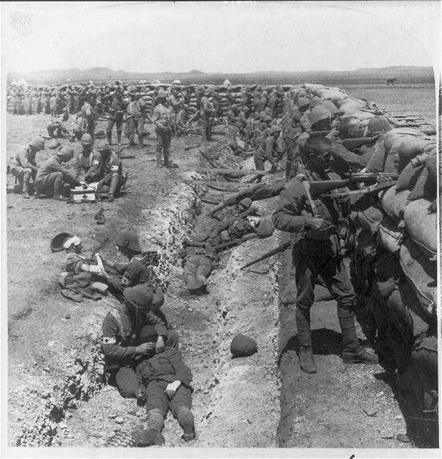
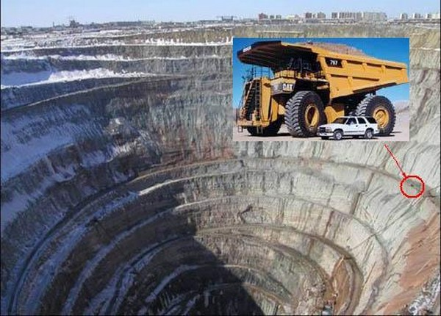
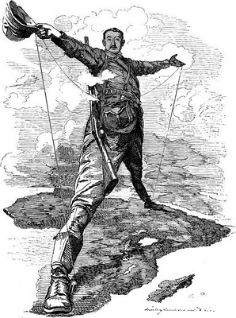
Boer Wars
Dutch East India Co. – Cape of South Africa
Boers – Dutch Settlers
British Colony – Zulu common enemy
The Great Trek – 2 States
1st Diamonds – Cecil Rhodes – DeBeers -1st War
2nd Gold – 2nd War

Slide 6
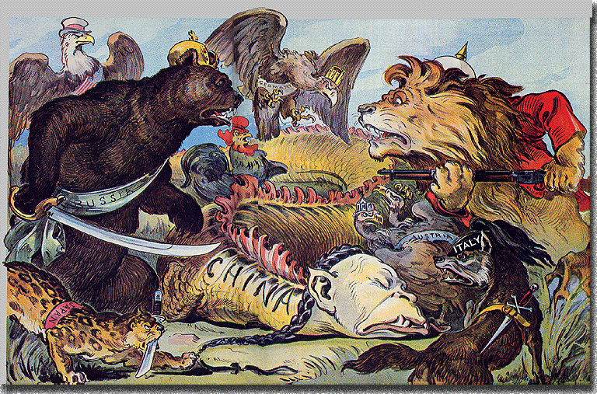
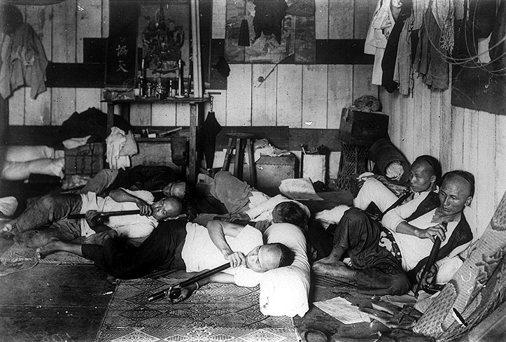
Opium War
England addicted to tea
China is addicted to nothing
Significantly limits trade with England
England gets China addicted to opium
12 million people
Opium Dens - Shanghaied
Treaty of Nanjing
Extraterritorial Rights
Hong Kong

