Slide 1
Background: Why Did 9/11 Happen?

Slide 2
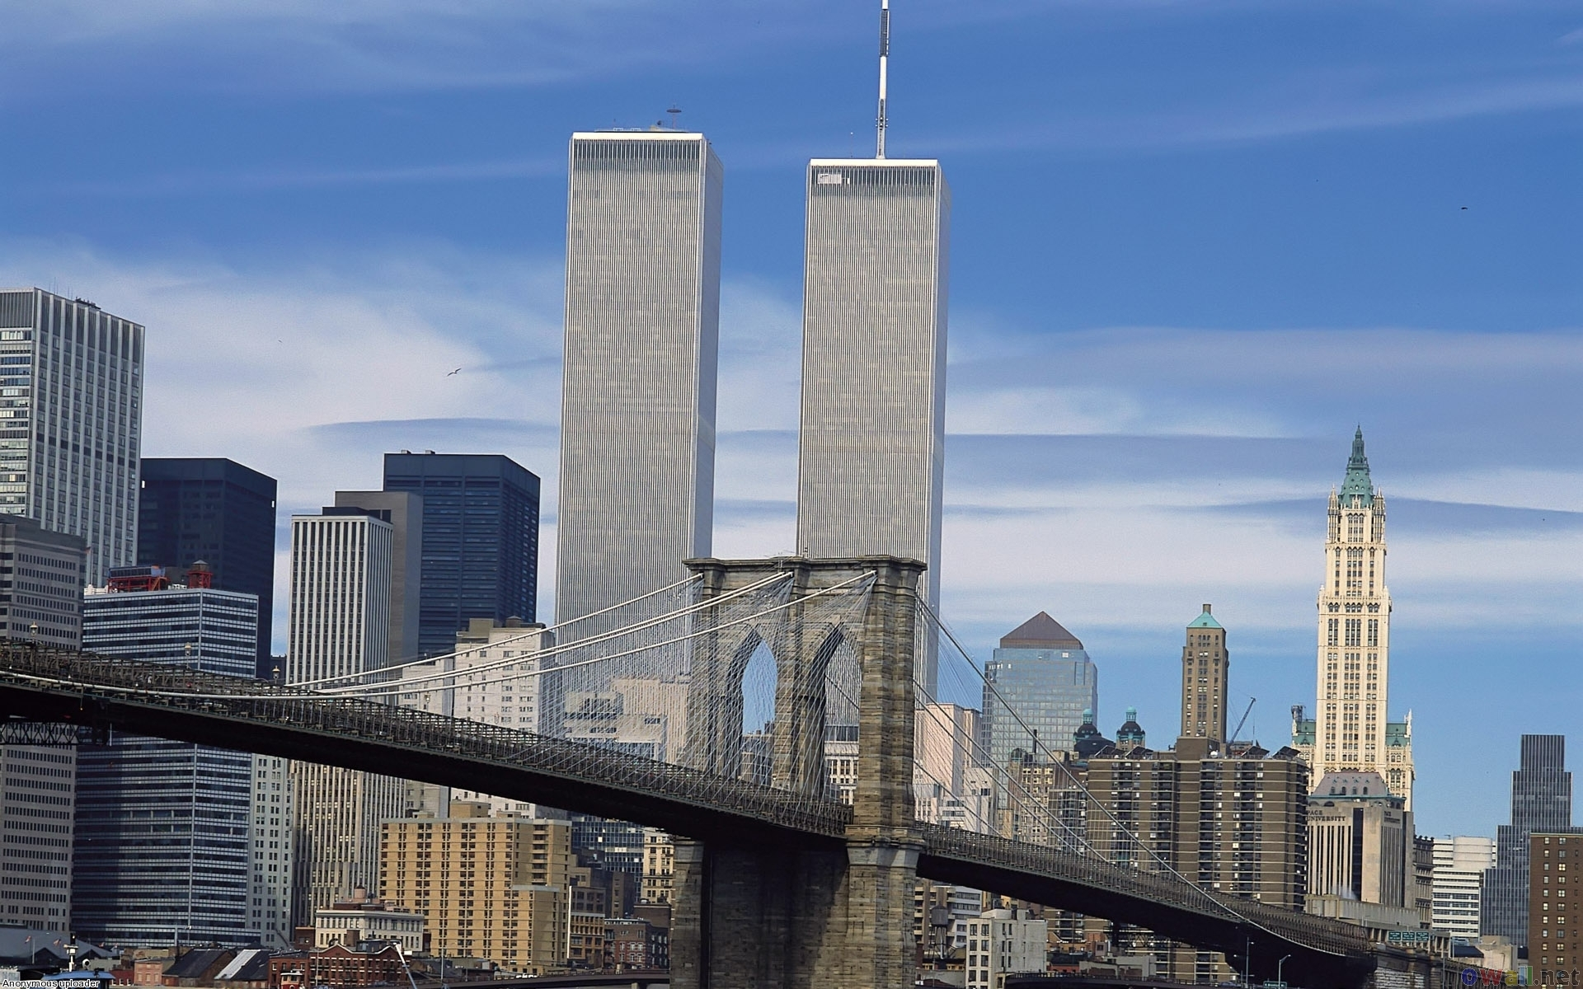

Slide 3
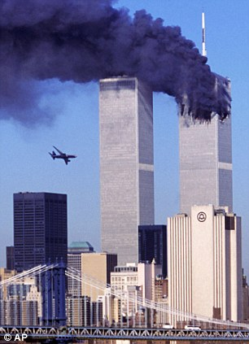

Slide 4
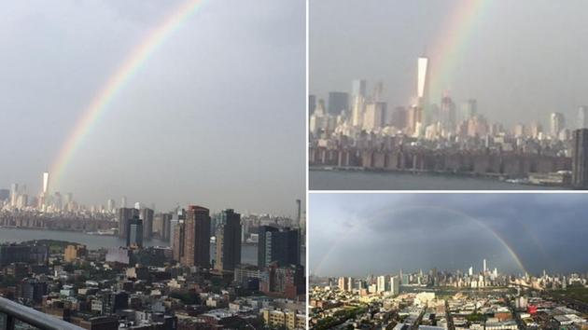

Slide 5
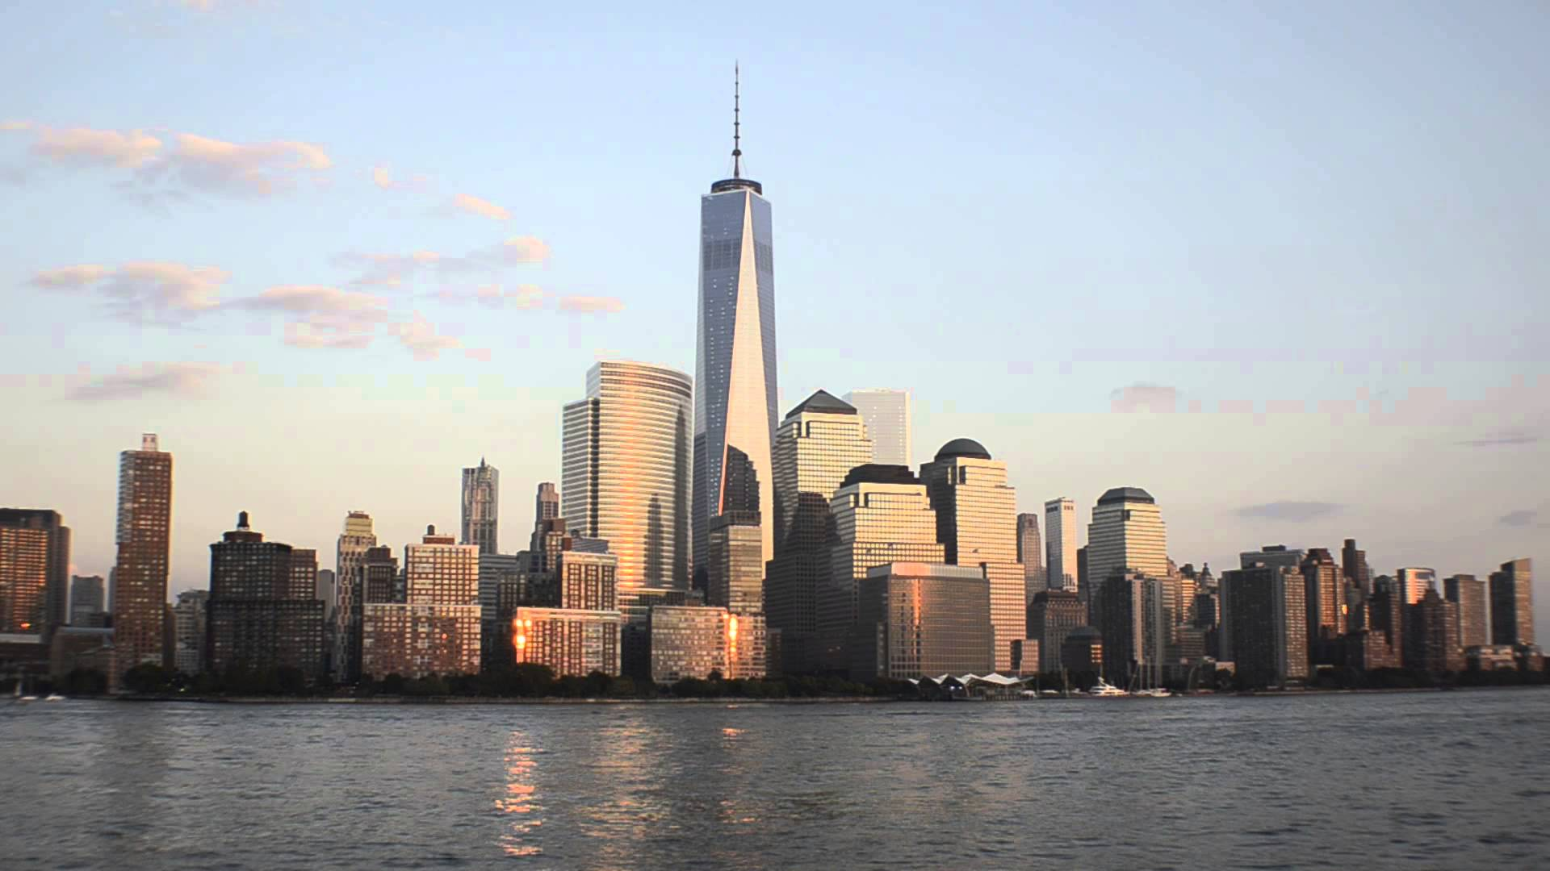

Slide 6
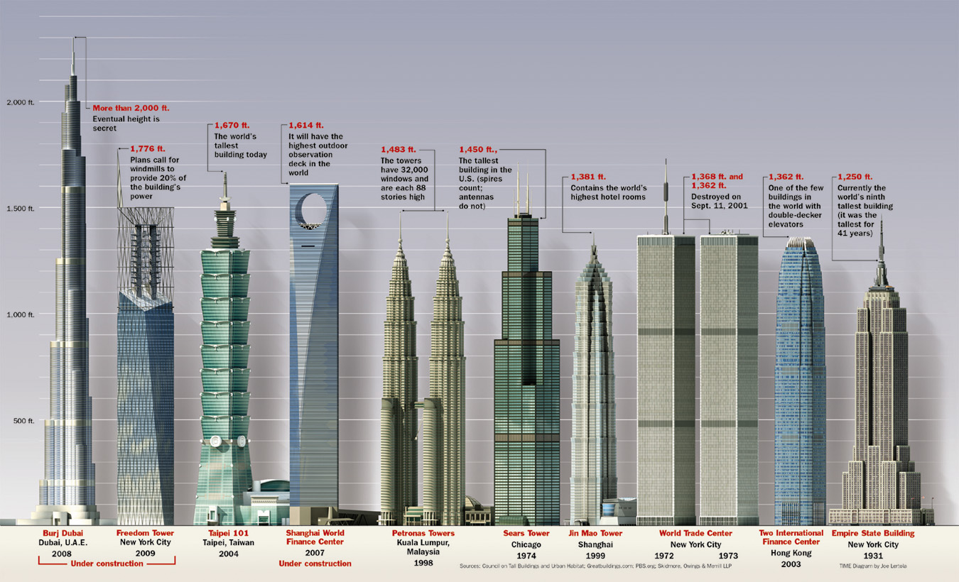

Slide 7
Al-Qaeda
Al-Qaeda
Mainly Arab-Muslim organization that disliked American foreign policy
American presence in Saudi Arabia, Israel, and others
Jihad- holy war, for protection
Plan for World Trade Center attacks started began in 1996

Slide 8
Motives
Support for the "attacks against Muslims" in Somalia
Support of Russian "atrocities against Muslims" in Chechnya
Support of authoritarian regimes in the Middle East such as Egypt, Saudi Arabia and Jordan
Support of Indian "oppression against Muslims" in Kashmir
The presence of U.S. troops in Saudi Arabia
U.S. support of Israel
The sanctions against Iraq

Slide 9
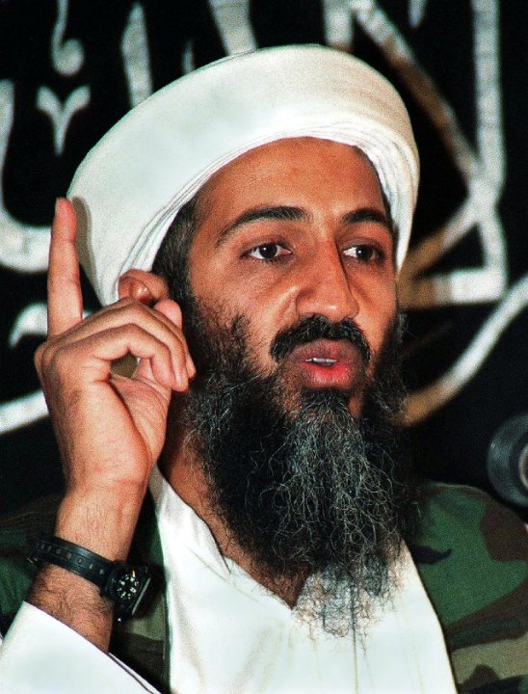
Bin Laden
Osama bin Laden
Leader of al-Qaeda
“It has become clear that the West in general and America in particular have an unspeakable hatred for Islam....Terrorism against America deserves to be praised because it was a response to injustice”
Admitted to leading attacks

Slide 10
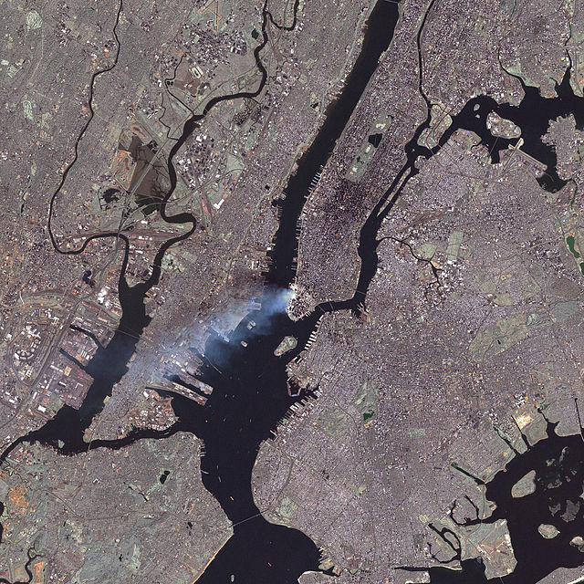
What Happened?
4 planes were hijacked by 19 terrorists
American Airlines Flight 11- Boston to LA
United Airlines Flight 175- Boston to LA
American Airlines Flight 77- Washington to LA
United Airlines Flight 93- Newark to SF
3 planes hit targets during morning of 9/11
AA11- North Tower
UA175- South Tower
AA77- Pentagon
1 plane did not
Passengers almost took control and plane crashed in open field in PA
http://www.jeffhead.com/attack/heroes.htm
http://highschoolsports.nj.com/news/article/-669088619070554974/football-princetons-david-beamer-sunshine-classic/

Slide 11
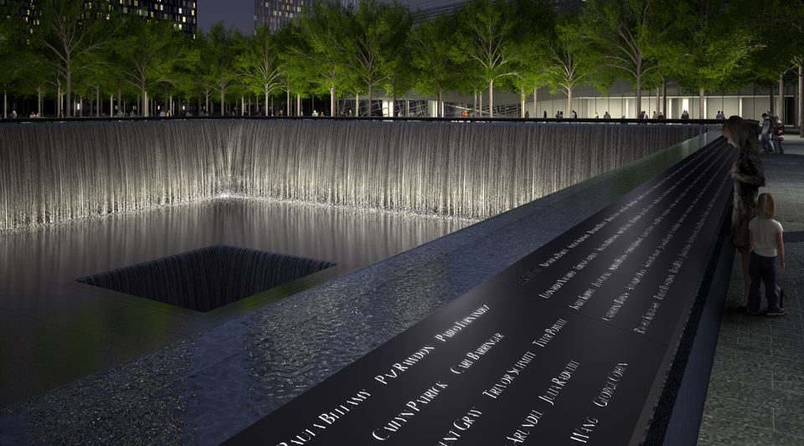
Results
Thousands killed and wounded
Heroic efforts of FDNY, NYPD, and everyday citizens
Increased support for President Bush
War on Terrorism in the Middle East
9/11 Commission created
War in the Middle East
Death of Bin Laden
Museum and Memorial

