Slide 1
The Middle/Dark Ages (500’s-1400’s)
Why would the time periods between the 500’s and 1400’s be considered “middle” and “dark”?

Slide 2
The Middle/Dark Ages
200-400’s CE | 500-1400’s CE | 1400-1600’s CE
Decline/Fall of the Roman Empire | The Middle/Dark Ages | The Renaissance

Slide 3
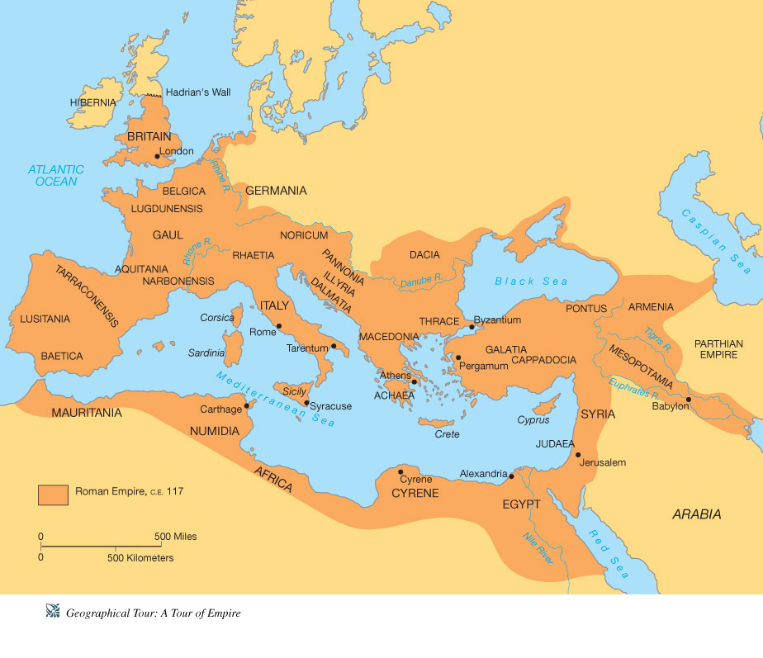
The Roman Empire at its Height

Slide 4
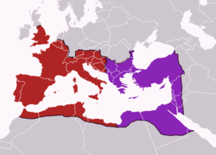
The Roman Empire Right Before its Fall

Slide 5
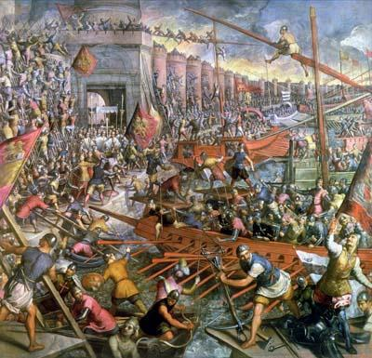
Decline and Fall of the Roman Empire
No Roman Army
Disruptive Economy
Disruption of Trade
Vast Social and Cultural Differences
Downfall of Cities
Governmental Power Struggles
Trade and Govt Collapsed
Nobles retreat
No leadership
Germanic Invasions

Slide 6
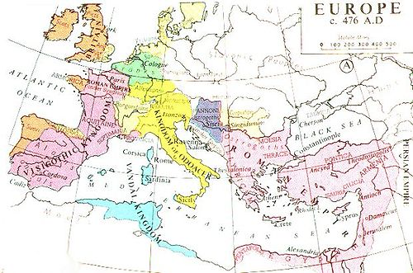
Europe After the Fall of the Western Roman Empire

Slide 7
The Fall of the Roman Empire Creates:
Instability and Chaos!!!

Slide 8
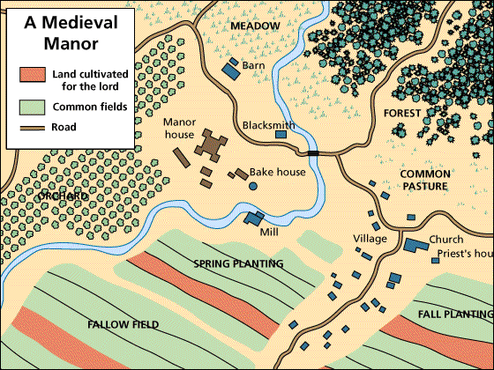
The 6 Outcomes
Middle/Dark Ages
Survival of the Fittest
Manorialism
System where peasants (aka serfs) gave land or freedom to lords for safety
In return peasants work land
15-30 families lived in manors.
Produced Everything
Paid taxes on all grain, marriage, and the tithe (church tax 1/10 income)

Slide 9
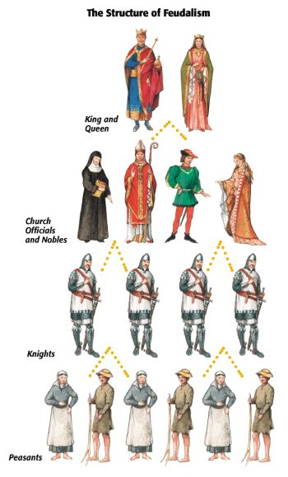
The 6 Outcomes Continued…
Feudalism
System where land (aka fief) granted in exchange for goods, services or protection
Hereditary

Slide 10
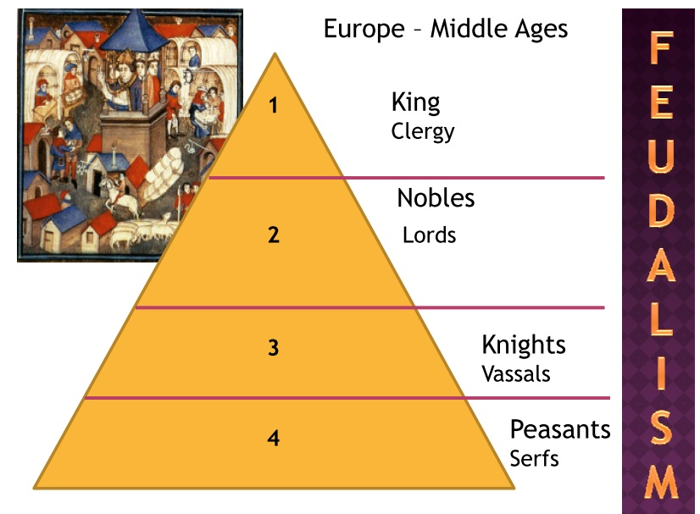

Slide 11
Idea of Gelasius: Pope should bow to emperor on politics. and emperor should bow to pope with religion. Does this work?
Structure of Church:
Pope: Head of Church
Clergy
Supervised priests
Clergy settled disputes over Church teachings
Priests were contact of Church
Unifying Force: Stable force during political turmoil
All could follow same path to salvation
Sacraments led to salvation

Slide 12
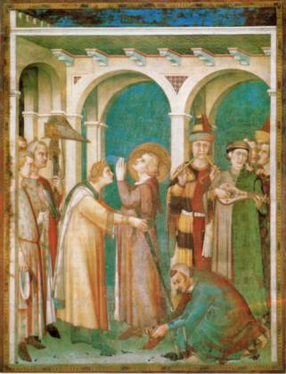
The 6 Outcomes Continued…
Rise of the Catholic Church
Religion = Most Important aspect of your life!!!
Church controlled…
Economy (Tithe)
Law (Canon Law)
Courts (Catholic conduct)
Education
Birth, marriage, death
Inheritance
Eventually power struggle w/ feudal lords

Slide 13
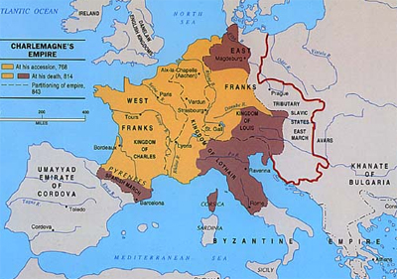
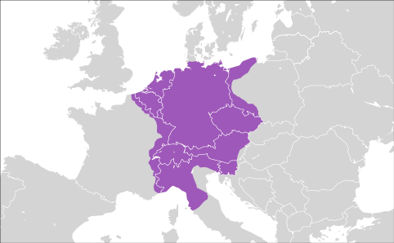
The 6 Outcomes Continued…
Holy Roman Empire (HRE) is Created
Cross b/w state and religious confederation
Attempt to revive the Roman Empire
Attempt to make political and religious leaders stronger
What need know:
Never a nation state/country
Very diverse
Pope appoints Emperor of HRE
Germans are almost always the Emperor

Slide 14
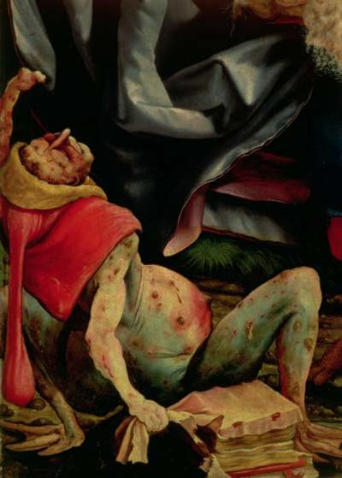
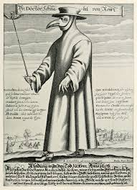
The 6 Outcomes Continued…
The Black Plague

Slide 15
