Slide 1
Section 2-3 Mexico War to Divided Nation (Growing Pains)

Slide 2
Uncle Tom’s Cabin by Harriet Beecher Stowe 1852
a. NORTH: kind vs. cruel, family, women, corruption of people’s Christian value, immoral, Northern Democratic Protestants of the Second Great Awakening,
b. SOUTH: book of exaggeration and lies, took a personal interest in health, one big family, northern industry just as brutal and have a work force of immigrants, north worried about profit not the well being of the individual, founding fathers had slaves so should we
c. NORTH: urban, industrial, large cities, diverse immigrants, 2x the population, RR system 70% in the north, different ways of living, telegraph

Slide 3
Warm UP:
What provisions were included in the Missouri Compromise?
Draw the consequences on your map along with the boarder between free and slave states.

Slide 4
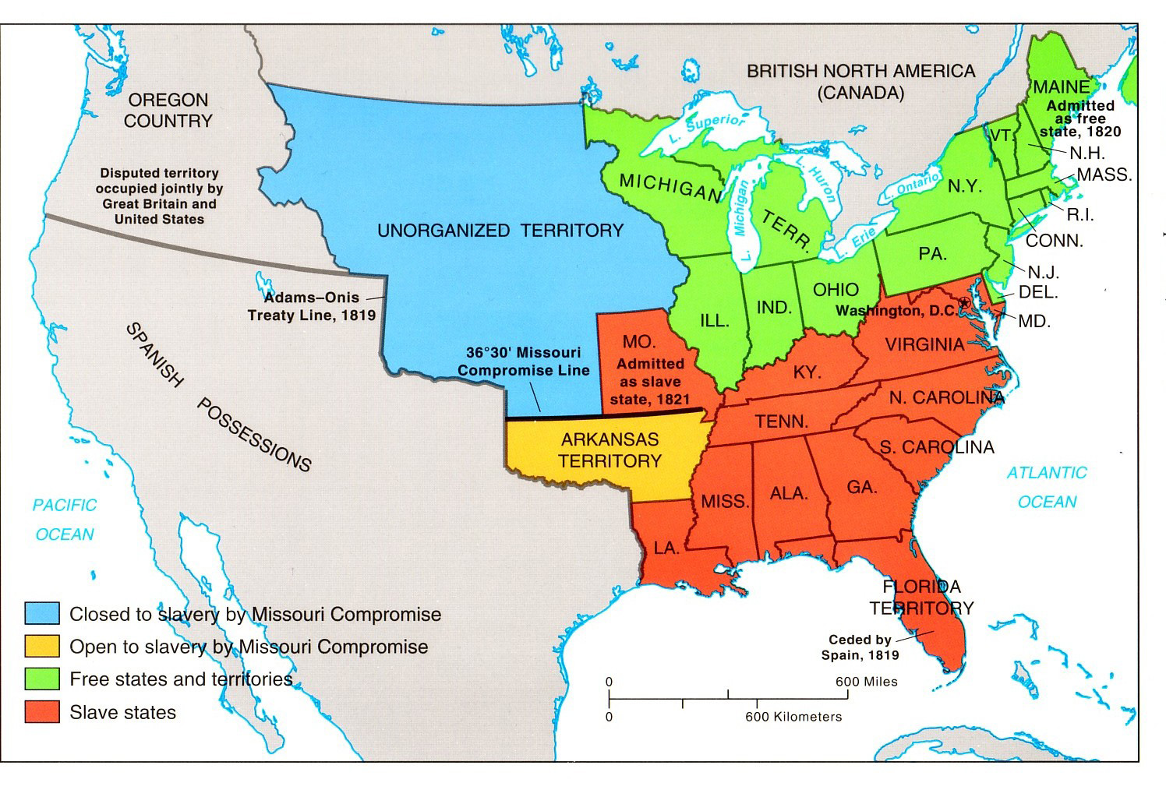

Slide 5
Notes:
CAUSES
United States annexes Texas in 1836
U.S. and Mexico disagree about the Southern Border
Mexico refuses to sell California and New Mexico to the U.S.
President Polk sends troops to establish the Rio Grande as the U.S.- Mexico border
Polk sends troops to California
U.S. Declares war on May 13, 1846
Effects
Rio Grande is established as the U.S.- Mexico border
U.S. acquires California and New Mexico
Debate over the expansion of slavery intensifies (GROWING PAINS)

Slide 6
The Mexican War: Causes and Effects
CAUSES
United States annexes Texas in 1836
Manifest Destiny
U.S. and Mexico disagree about the Southern Border
Mexico refuses to sell California and New Mexico to the U.S.
President Polk sends troops to establish the Rio Grande as the U.S.- Mexico border
Polk sends troops to California which was revolting\Republic
U.S. Declares war on May 13, 1846
Effects
Rio Grande is established as the U.S.- Mexico border
U.S. acquires California and New Mexico
Debate over the expansion of slavery intensifies (GROWING PAINS)

Slide 7
Henry Clay (Kentucky) presents the Compromise of 1850:
Congress would admit California as a free state
The people of the territories of New Mexico and Utah would decide for themselves whether slavery would be legal.
Congress would abolish the sale of slaves, but not slavery, in Washington D.C.
Texas would give up claims to New Mexico for $10 million
A Fugitive Slave Act would order all citizens of the United States to assist in the return of enslaved people who had escaped from their owners. It would also deny a jury trial to escaped slaves

Slide 8
Compromise of 1850 Who seems to be gaining the upper hand?

Slide 9
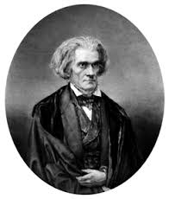
John C. Calhoun- South Carolina Senator
March 4, 1850- gives a speech in reaction
67 year old senator was ill and asked James Mason of Virginia to read speech for him
North’s growing population had given it more representatives in the House and more votes in the Electoral College.
South had the right to leave the union if necessary
Stopping slavery was morally wrong- interfered with their liberty to own enslaved people as property
Governments responsibility was to be limited, excepted by all, AND protect property

Slide 10
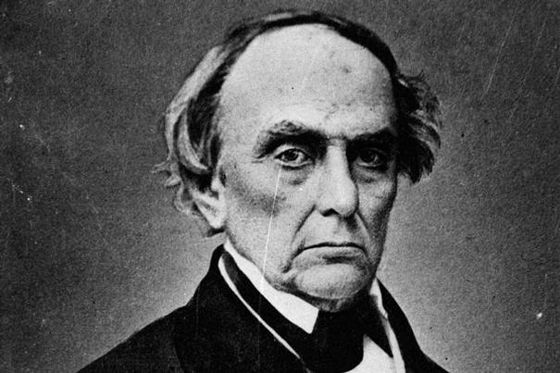
Daniel Webster Favors Compromise
Massachusetts Senator (Northern perspective)
Supported Clay’s compromise- slavery in New Mexico would never be practical
It is our constitutional duty to return fugitive slaves
Outraged northern abolitionists- Webster sold out on abolition in an effort to preserve trade!
Congress passed the compromise of 1850
South not satisfied- Calhoun’s fears momentarily put on hold
Fugitive Slave Act made matters worse- many angry in the north
Compromise did nothing- only made California free

Slide 11
Changes in Political Parties
Decline of the Whig Party
Where do the Whigs trace their roots to?
Old issues like banking had been resolved
Prominent leaders were fading away
Continued dominance of the Democratic Party
Rise of the Know- Nothings
Slavery was not the only major issue
Nativism- movement to ensure NATIVE born Americans receive better treatment than immigrants
1846-1854- 3 million Europeans arrived
Protestants angry about the rise of Catholics especially from Ireland
Irish Potato Famine- 1845-1849- hundreds of thousands of Irish fled to the U.S.
In 1854- nativists went public by forming a political organization called the American Party- ANTI Irish Catholics
RECEIVED the nickname the “Know- Nothings”
Did well in local elections especially in the urban north

Slide 12
Kansas Nebraska Act
Senator Stephen Douglas of Illinois- conflicting ambitions- NORTHERN DEMOCRAT
Wanted Chicago to benefit from the development of the WEST- If Kansas and Nebraska become states, railroads could be built across their land to link Chicago
Douglas also wanted to run for president
Needed support of the southern democrats
Reminder- Missouri Compromise would make Kansas and Nebraska FREE!
To win support of Northerners and Southerners, he introduced the Kansas and Nebraska ACT
Popular Sovereignty- letting the people in a territory decide whether to allow slavery instead of restricting the decision making power to Congress.
Essentially repeal 36 30 parallel line
SOUTH obviously happy!
Douglas thought the North would be happy as well
Possibilities for future development
No chance they would vote for slavery on the Northern Great Plains- cotton can’t grow there

Slide 13
Kansas and Nebraska Act-

Slide 14
Stephen Douglas Self interested? Sellout to the North? Compromiser?

Slide 15
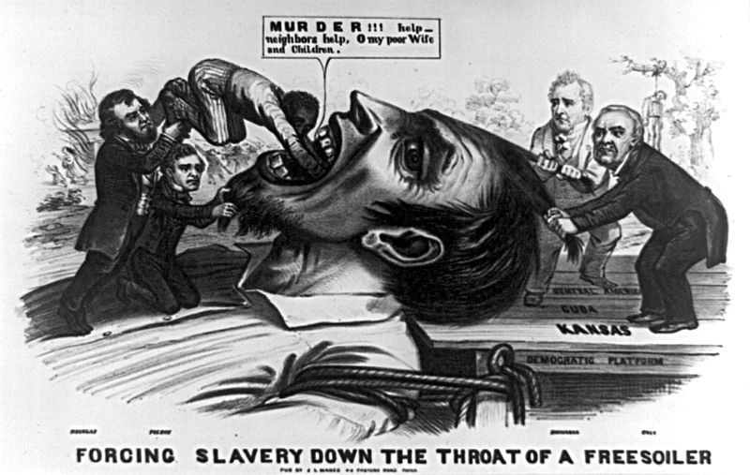
Republican Party is born!
Disgusted northerners held meetings in Michigan in protest to Kansas and Nebraska Act
Formed a new Republican Party
This is the same party we have today- Ironically very liberal for its time (b/c of slavery)
Stop slavery
Repeal the Kansas Nebraska Act and the Fugitive Slave Act

Slide 16
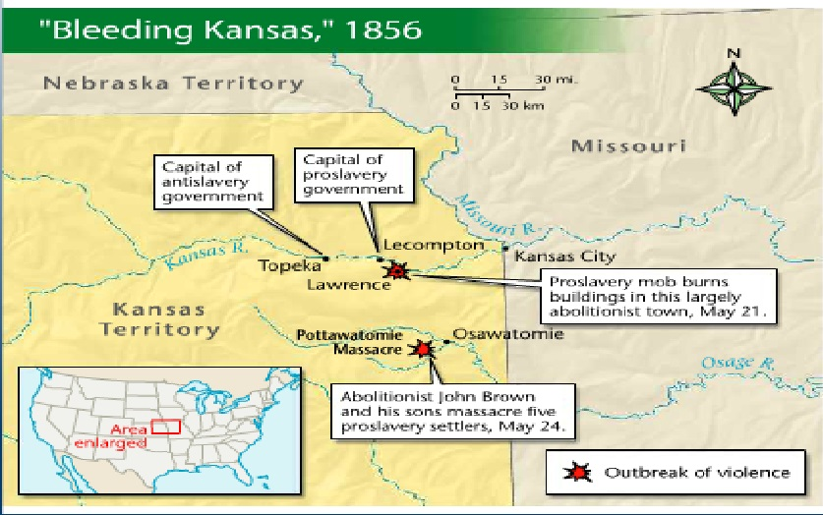
Battle over Kansas!
Antislavery groups in the Northeast set up so called Emigrant Aid Societies in 1854-1855 to send 1200 New Englanders to Kansas to fight against slavery.
Free soilers- person dedicated to preventing the expansion of slavery into the western territories
By 1855, Kansas had two competing capitals
Antislavery capital at Topeka
Proslavery capital at Lecompton

Slide 17
Election of 1856

Slide 18
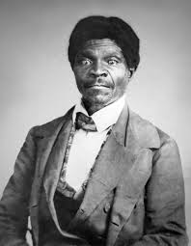
Dred Scott v. Sandford (1857)
Dred Scott- enslaved man living in Missouri, filed suit against his owner
Argued that b/c he and his wife, Harriet, had once lived in states and territories where slavery was illegal, the couple was in fact free
Supreme Court ruled 7-2 against Scott
Scott-AND ALL SLAVES- were not citizens and had no right to sue in court
Missouri Compromise AND the Northwest Ordinance was Unconstitutional
Slaves were the property of their owners and Congress could not deprive people of their property without due process of law according to the 5th Amendment
What happened to the federalists and John Marshall?
Marshall and the federalist court lasts until 1835
Democratic dominance in the White House leads to VERY CONSERVATIVE judges!
Chief Justice Roger Taney
“No word can be found in the Constitution, which gives Congress a greater power over slave property, or which entitles property of that kind to less protection than property of any other description. The only power conferred (granted) is the power coupled with the duty of guarding and protecting the owner in his rights.”

Slide 19
The Lecompton Constitution
1857- a small proslavery group in Kansas elected members to a convention to write the constitution required to attain statehood.
Lecompton Constitution was proslavery
Most Kansans were opposed to slavery
Refused to vote in referendum b/c both options on the ballot would have protected slavery in Kansas.
President Buchanan endorsed the constitution
Constitution was killed in a revote
For the time being, Kansas remained a territory where slavery was legal according to the Dred Scott decision but in reality, the free soiler majority prohibited slavery.

