Slide 1
Chapter 4 Section 4
Fighting for Independence

Slide 2
Lexington and Concord
April 1775
Where: Massachusetts about 20 miles west of ___________
What: The 1st CC asked colonists to assemble and train militias. As part of that, colonists in Massachusetts were ___________________________________. British troops tried to take these weapons.
Result: The Patriot were able to protect their stash of weapons and pushed the British soldiers back to Boston.
http://www.history.com/topics/american-revolution/american-revolution-history/videos/first-revolutionary-battle-at-lexington--concord

Slide 3
Strengths and weaknesses
British strengths and weaknesses
American strengths and weaknesses

Slide 4
The Siege of Boston
1775-1776
Where: Boston, Massachusetts
What: After Lexington and Concord ______________________ (American soldiers) were able to _______________________ General Gage and his 6,000 British troops and prevent them from moving while the Americans gathered military supplies.
Result: Eventually this will cause the British to flee Boston.

Slide 5
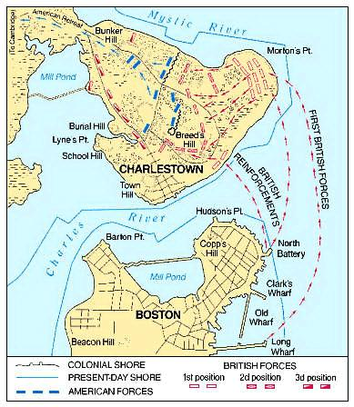
Battle of Bunker Hill: June 1775
Where: Patriots occupied 2 hills North of Boston
What: The Patriots were able to use their position on higher ground to push the British back twice killing 1,100 of the 2,400 British troops
After these 2 waves of attacks the ______________had ___________ almost all of their ______________ and had to retreat
Result: This allowed the British to launch a 3rd attack and take the hill. _______________victory; BUT they lost many, many lives
http://www.history.com/topics/american-revolution/siege-of-boston/videos

Slide 6
The British leave Boston
British troops were pinned down in Boston for the next __________months.
In July 1775, George Washington arrived and as newly named commanding general of the Patriot forces, worked to transform the militia groups into the Continental Army.
In March 1776, the ____________________ Boston and headed to Canada.

Slide 7
War is officially declared
When: July 4, 1776
What: The Declaration of Independence is signed
Result: this changes the goals of the Americans.
Before the Declaration some Americans thought this was just a conflict between the colonies in New England and Great Britain.
Others thought that the fighting was just a way to get Great Britain to honor the rights of the Americans and when it was over we would still be colonies of GReat Britain
This makes it official, we are fighting to become an _________________________________.

Slide 8
British focus on fighting in the Middle Colonies
When: July 1776-Jan 1777
What: After the British fled Boston they decided to focus on the ___________________________ because more loyalists lived there. The British were winning most of the battles pushing to Americans out of NY, across NJ and into PA. Washington and his men needed a victory.

Slide 9
Thomas Paine’s Crisis Papers is published
When: Dec 1776
What: The colonists were ___________________ and many Americans believed they were going to lose the war. Paine created a pamphlet meant to inspire the colonists so they would keep fighting for victory.
Result: ________________ many Americans to keep fighting
“ These are the times that try men's souls. The summer soldier and the sunshine patriot will, in this crisis, shrink from the service of their country; but he that stands by it now, deserves the love and thanks of man and woman. Tyranny, like hell, is not easily conquered; yet we have this consolation with us, that the harder the conflict, the more glorious the triumph.” - Crisis Papers

Slide 10
Battle of Trenton
Where: Trenton, NJ
When: December 25-26, 1776
What: Washington and his men, inspired by the words of Paine, crossed the ______________________ from PA to NJ to launch a surprise attack on the _________________ and _________________ troops stationed there.
Result:
American victory
Boosted American morale
Convinced more men to enlist
Led to an American victory at the Battle of Princeton

