Slide 1
Emergency Procedures

Slide 2
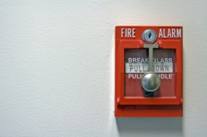
Fire Drill
AS A CLASS-
1) Walk out the class door
2) Proceed down stairs/hallway
3) Exit the building through designated door
4) Assemble together in designated area
5) Take Attendance
6) Await further instructions

Slide 3
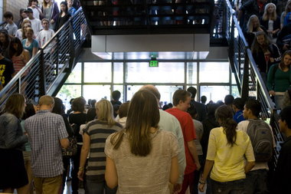
Evacuation Drill
AS A CLASS-
1) Walk out the class door
2) Proceed down stairs
3) Exit the building through designated door
4) Assemble together in designated area
5) Take Attendance
6) Await further instructions

Slide 4
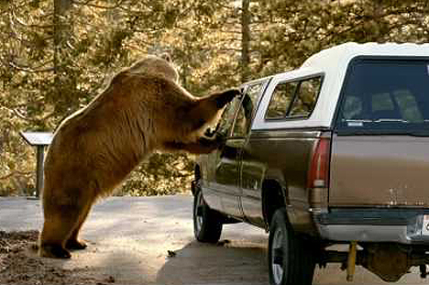
Lockout- Securing the Perimeter
1) Class door will be closed and locked
2) Instruction will continue as normal

Slide 5
Lockdown-
1) Close and lock class door
2) Lights out
3) Gather in safe corner of class out of the door’s line of sight
4) REMAIN SILENT!!!
5) NO CELL PHONES!!!
6) Await further instructions

Slide 6
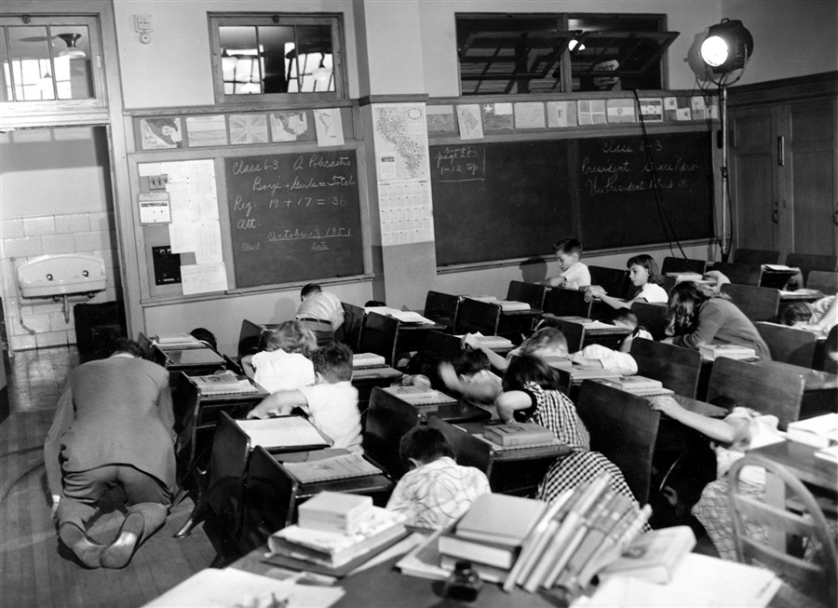
Nuclear War
1) Duck and Cover!!
Trust us, it will work!

