Slide 1
Human Evolution
CHAPTER 19

Slide 2
19.1 primates
Primates -Lemurs, tarsiers, monkeys, apes
Adapted for a arboreal (in trees) lifestyle
Limber shoulder and hip joints for moving in trees
Mobile and sensitive hands and feet
Overlapping fields of vision for depth perception
Extensive parental care

Slide 3
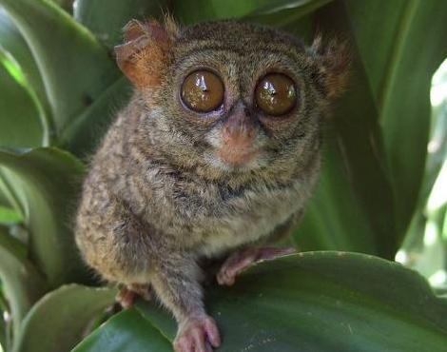

Slide 4
Apes
Gibbons, orangutans, gorillas, chimpanzees, and humans
No tail
Opposable thumbs
Large brain, complex behavior
Social organization
Chimps use sign language, raid other chimp family groups, and make simple tools

Slide 5
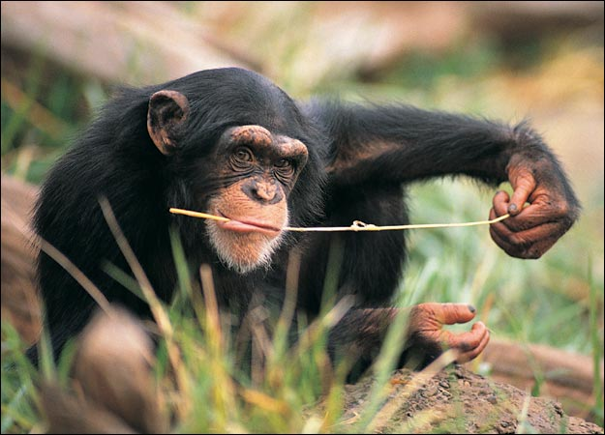

Slide 6
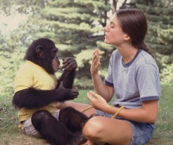

Slide 7
19.3 Human family tree
Humans and chimps diverged from a common ancestor 5 to 7 million years ago
Derived traits
Bipedal, shorter jaw, larger brain, language, symbolic thought, manufacture and use of complex tools
Hominids- more human like than ape like

Slide 8
Bipedalism
Evolved before increase in brain size
“Lucy” – fossilized hominid – 3 million years old
Australopithecus afarensis
Skeleton was 40% complete
1 meter tall
Head the size of a softball
Was clearly bipedal

Slide 9
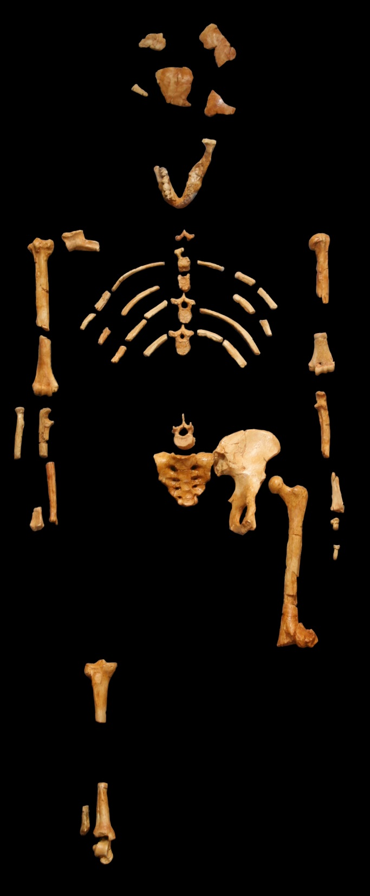

Slide 10
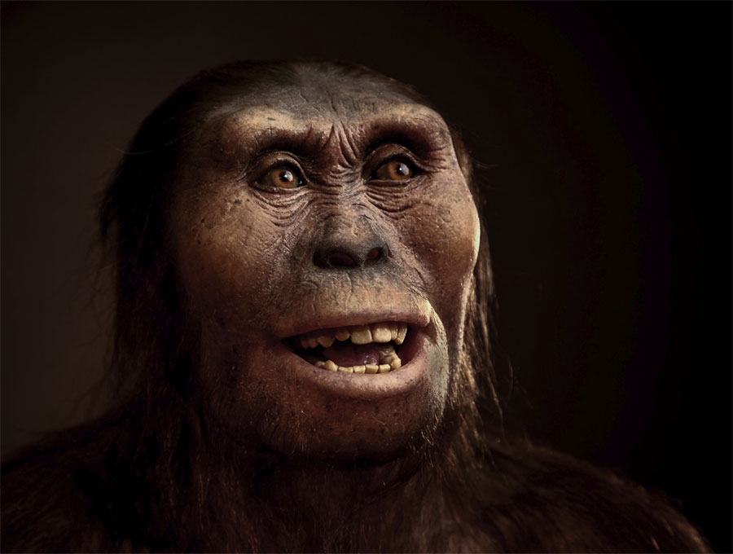

Slide 11
Hominids with larger brains
Homo habilis “Handy Man”- created sharp stone tools
Homo erectus – first to migrate out of Africa
Neanderthal Man-fossils found in Europe

Slide 12
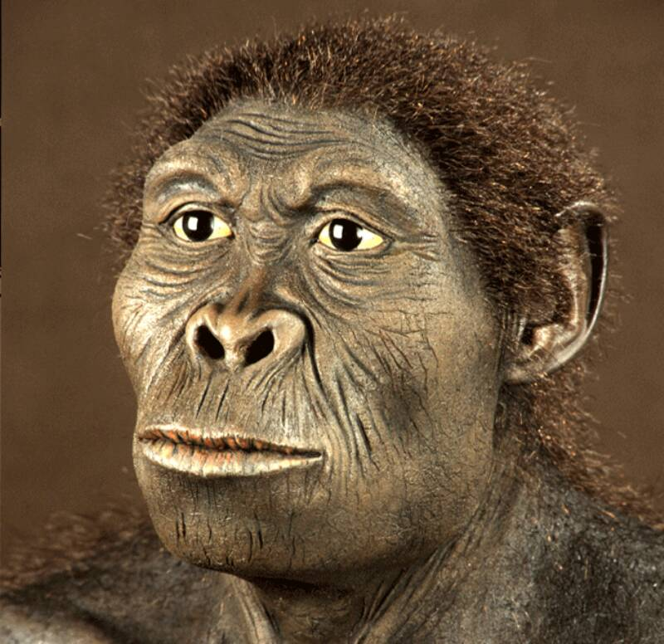

Slide 13
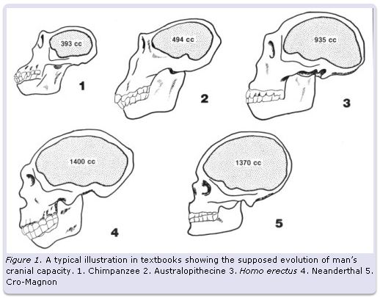

Slide 14
Modern man
Capable of symbolic thought as evidenced by art and other artifacts
Cro- Magnon Man

Slide 15
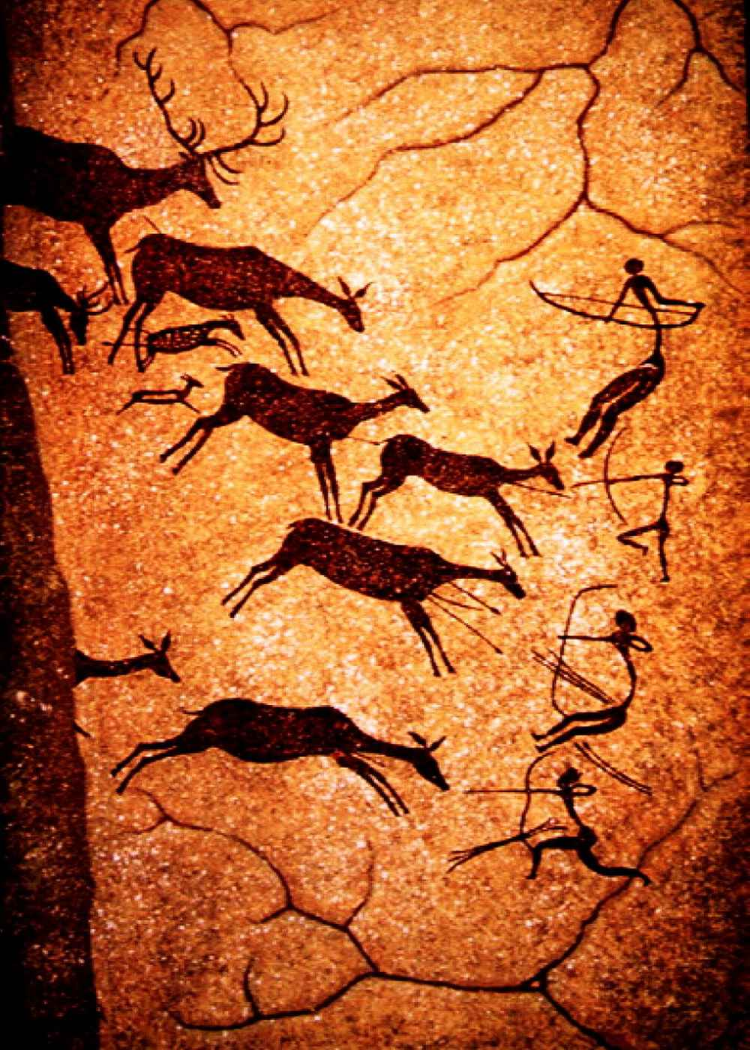

Slide 16
19.9 Human Culture
Pass on accumulated knowledge, customs, beliefs, art, and other products by means of written and spoken language
Culture has allowed humans to overcome physical limitations and alter nature

Slide 17
19.10 Hunter/Gatherer
Earliest hominids were hunter/scavenger/gatherers
Tool manufacture allowed for more efficient hunting
Division of labor

Slide 18
19.11 Agriculture
People settled in one place and began growing crops and domesticating animals
Led to population increases, food surplus, and accumulation of wealth
Not all people in a community had to grow food and other occupations and interests developed

Slide 19
19.12 Industrialization
Use of complex tools, machines and technology has industrialized our culture
Has allowed for even greater population growth due to
Better sanitation
Better nutrition
Better healthcare
As a result we have caused significant changes to the earth’s surface

