Slide 1
“what the bourgeoisie therefore produces, above all, are its own grave-diggers. Its fall and the victory of the proletariat are equally inevitable.”
- Karl Marx & Friedrich Engels

Slide 2
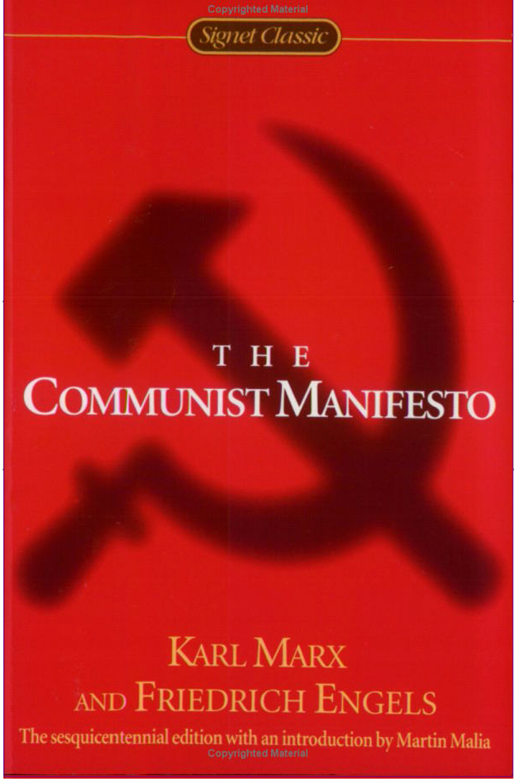
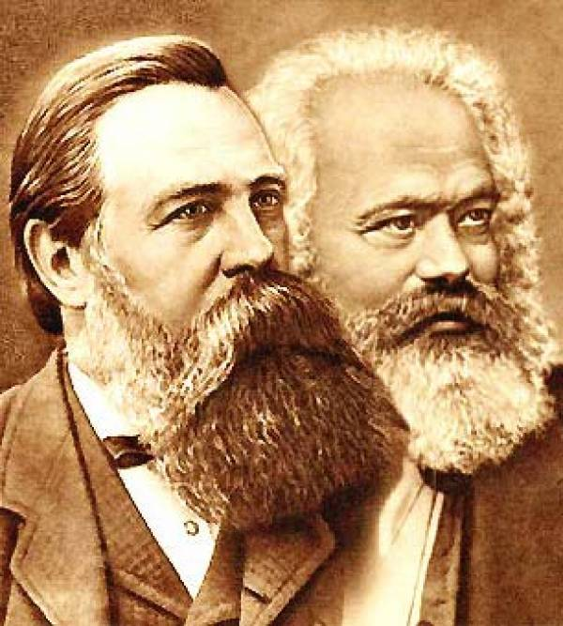
Engels
Marx
The Communist Manifesto | 1848

Slide 5
What if you were there?
You’ve overheard people talking about this new ‘manifesto’ and decided to read it for yourself.
Write a diary entry as Edward L.R. Smyth, a well-to-do businessman and factory owner having just read the Communist Manifesto. [be sure to cite specific passages that you reacted to or connected with]
You were given the ‘manifesto’ by a co-worker and have just read it.
Write a diary entry as Matilda Hoffler, a single 20 year old factory worker from Frankfurt, Germany having just read the Communist Manifesto. [be sure to cite specific passages that you reacted to or connected with]
Each diary entry should be at least one paragraph long. Be sure to write with each person’s voice, really take on their role.

